Slide 1
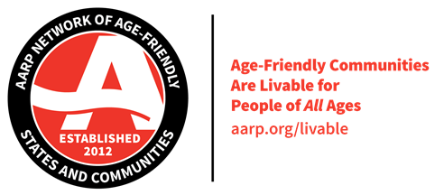
AARP Network of Age-Friendly States and Communities
Linda Kruger, Juneau Community Action Team

Slide 2
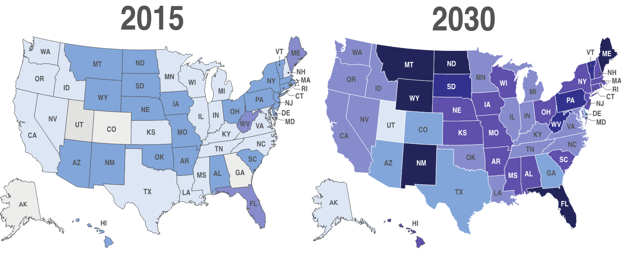
America is aging
PERCENT OF POPULATION AGE 65+
Source: US Census

Slide 3
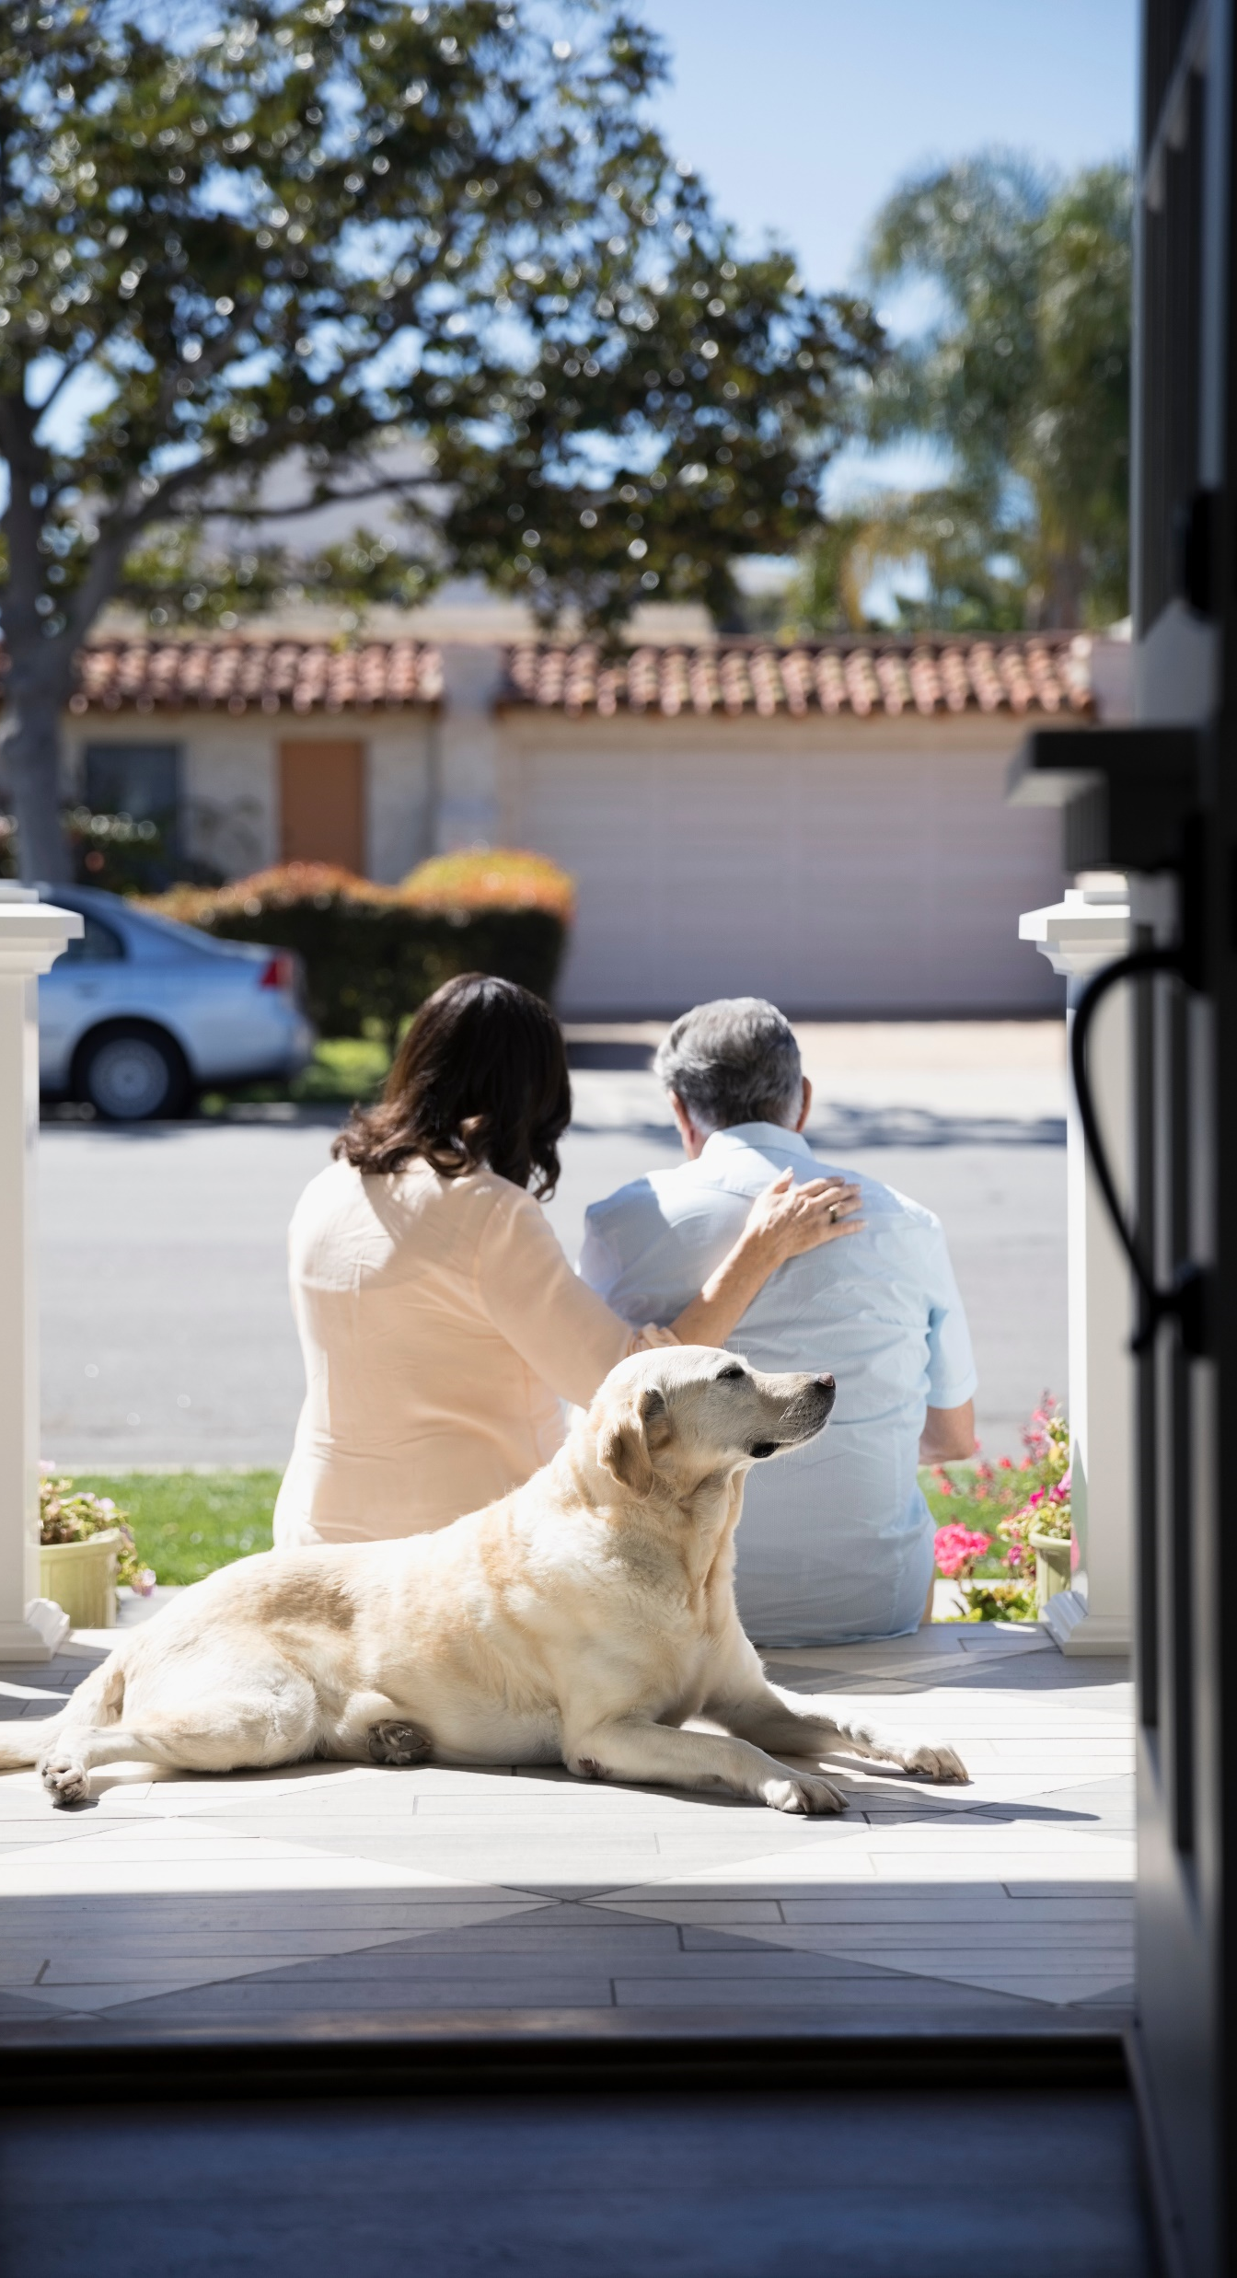
People want to stay in their homes
and communities…
Two-thirds (67%) of all adults — and 79% of those 50-plus — want to stay in their current communities. Adults primarily value communities that foster good health, promote street safety, and provide good opportunities for community engagement and social interaction.
High numbers of Americans want “forever homes” — to stay in their current homes as they age. The percentage is even higher for adults age 50-plus, with more than three-quarters wanting to remain in their home as they age. But more aging-in-place modifications and technology are needed to make that possible.
Source: AARP Home and Community preferences Survey 11/21

Slide 4
What is the first thing that comes to mind when you hear the term, “Age-Friendly”?

Slide 5
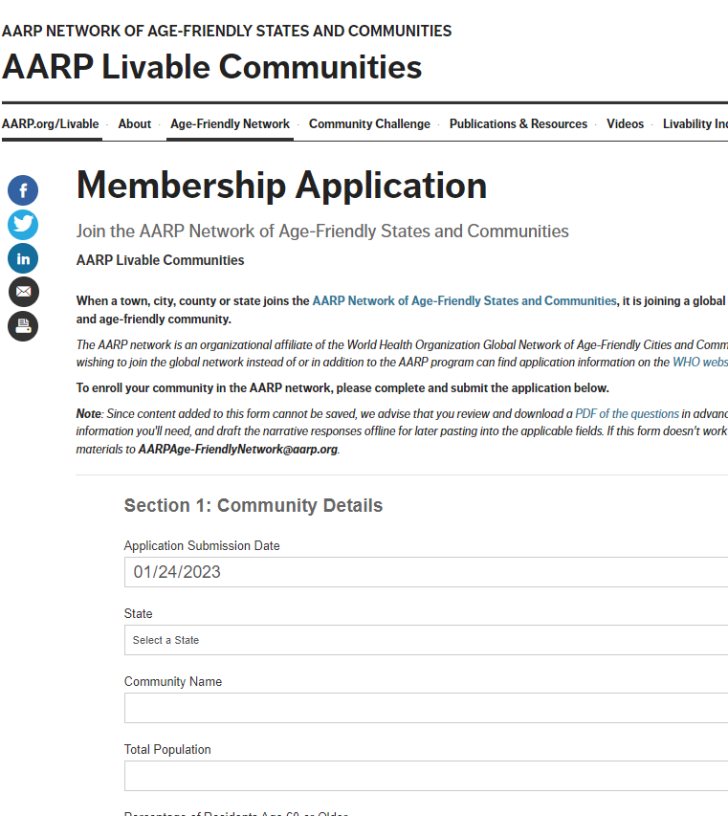
An Age-Friendly Community is…
…one where a community’s elected leadership has made a commitment to actively work with residents and local advocates to make their town, city, or county an age-friendly place to live through enrollment in the AARP Network of Age-Friendly States and Communities!

Slide 6
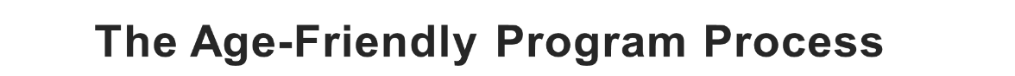
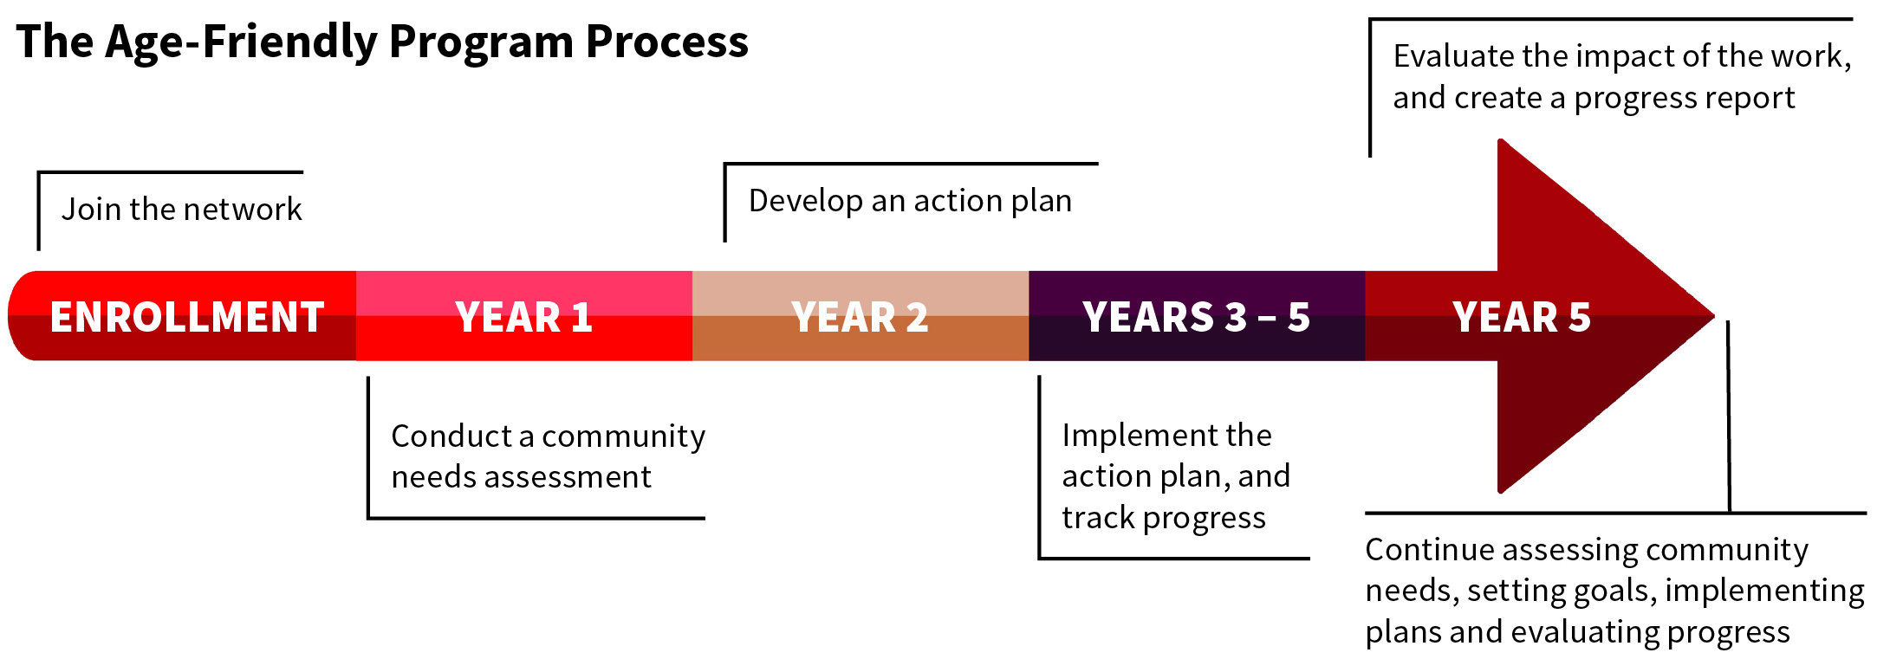
All communities seeking to enroll in the AARP age-friendly network are required to submit a membership application and commit to a 5-year process of improvement which includes:
conducting a community needs assessment
implementing and assessing the plan’s impact
developing an action and evaluation plan
the voice of older residents in all stages of planning and implementation

Slide 7
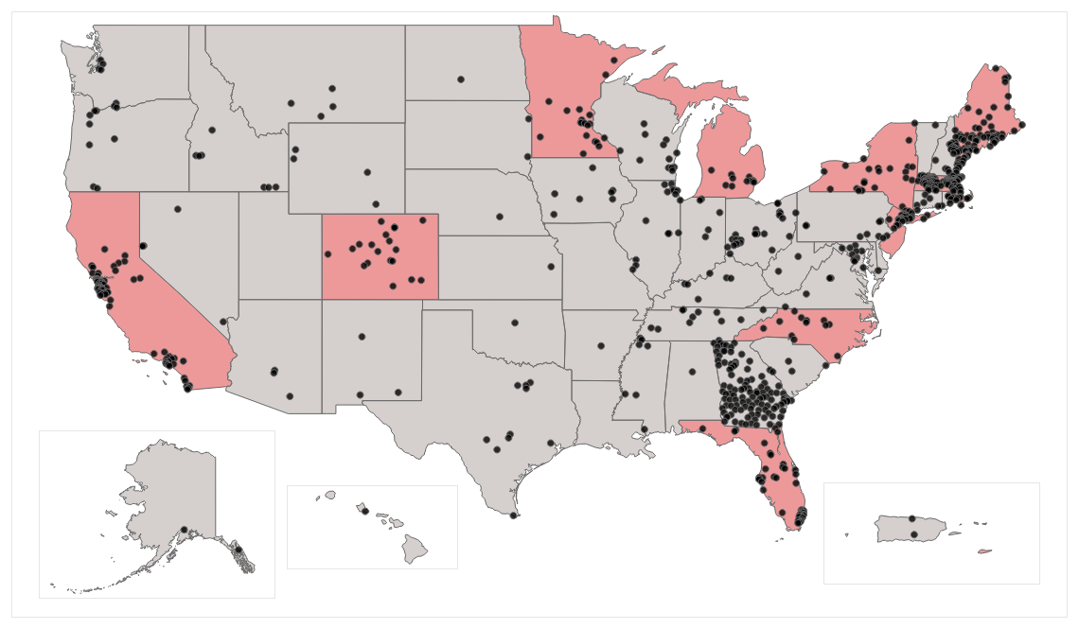
AARP Network of Age-Friendly States and Communities (NAFSC)
There are currently 790 communities, 10 states and 1 territory enrolled (updated 10.5.23)

Slide 8
Benefits of Enrolling
Membership in the network:
Membership provides a community with:
Serves as an organizing structure for making community improvements
Access to technical assistance and expert-led webinars
Fosters partnerships among community groups and local stakeholders
Access to a national network of over 700 communities enrolled in the network
Enables changes that benefit people of all ages
Support and best practice materials from AARP
Provides resources for identifying and assessing community needs
Help for local leaders to identify and understand community needs

Slide 9

AARP NAFSC 2022 Member Survey
Impact of Joining
68%
Advocated for Policy Change
Age-friendly initiatives are catalyzing local policy change. Nearly 2:3 age-friendly communities reported that they had successfully advocated for changes in municipal or organizational policy.
86%
Overcame Barriers to Age-Friendly Change
The NAFSC 5-year program cycle and framework is setting communities up for success. By applying the age-friendly programmatic framework, respondents reported overcoming barriers to improve the community for older residents.
Notes:
Note: Communities report that enrollment in age-friendly has helped them become successful in overcoming some of the following barriers.
NAFSC Role in Overcoming Barriers, n=140
Private Sector Has Taken Action 13%
Public Policies Enacted 29%
Public Sector Has Taken Action 34%
Improved Regional Coordination 36%
Improved Municipal Service Coordination 41%
Improved Service Coordination 42%
Increased Public Support for Aging 43%

Slide 10
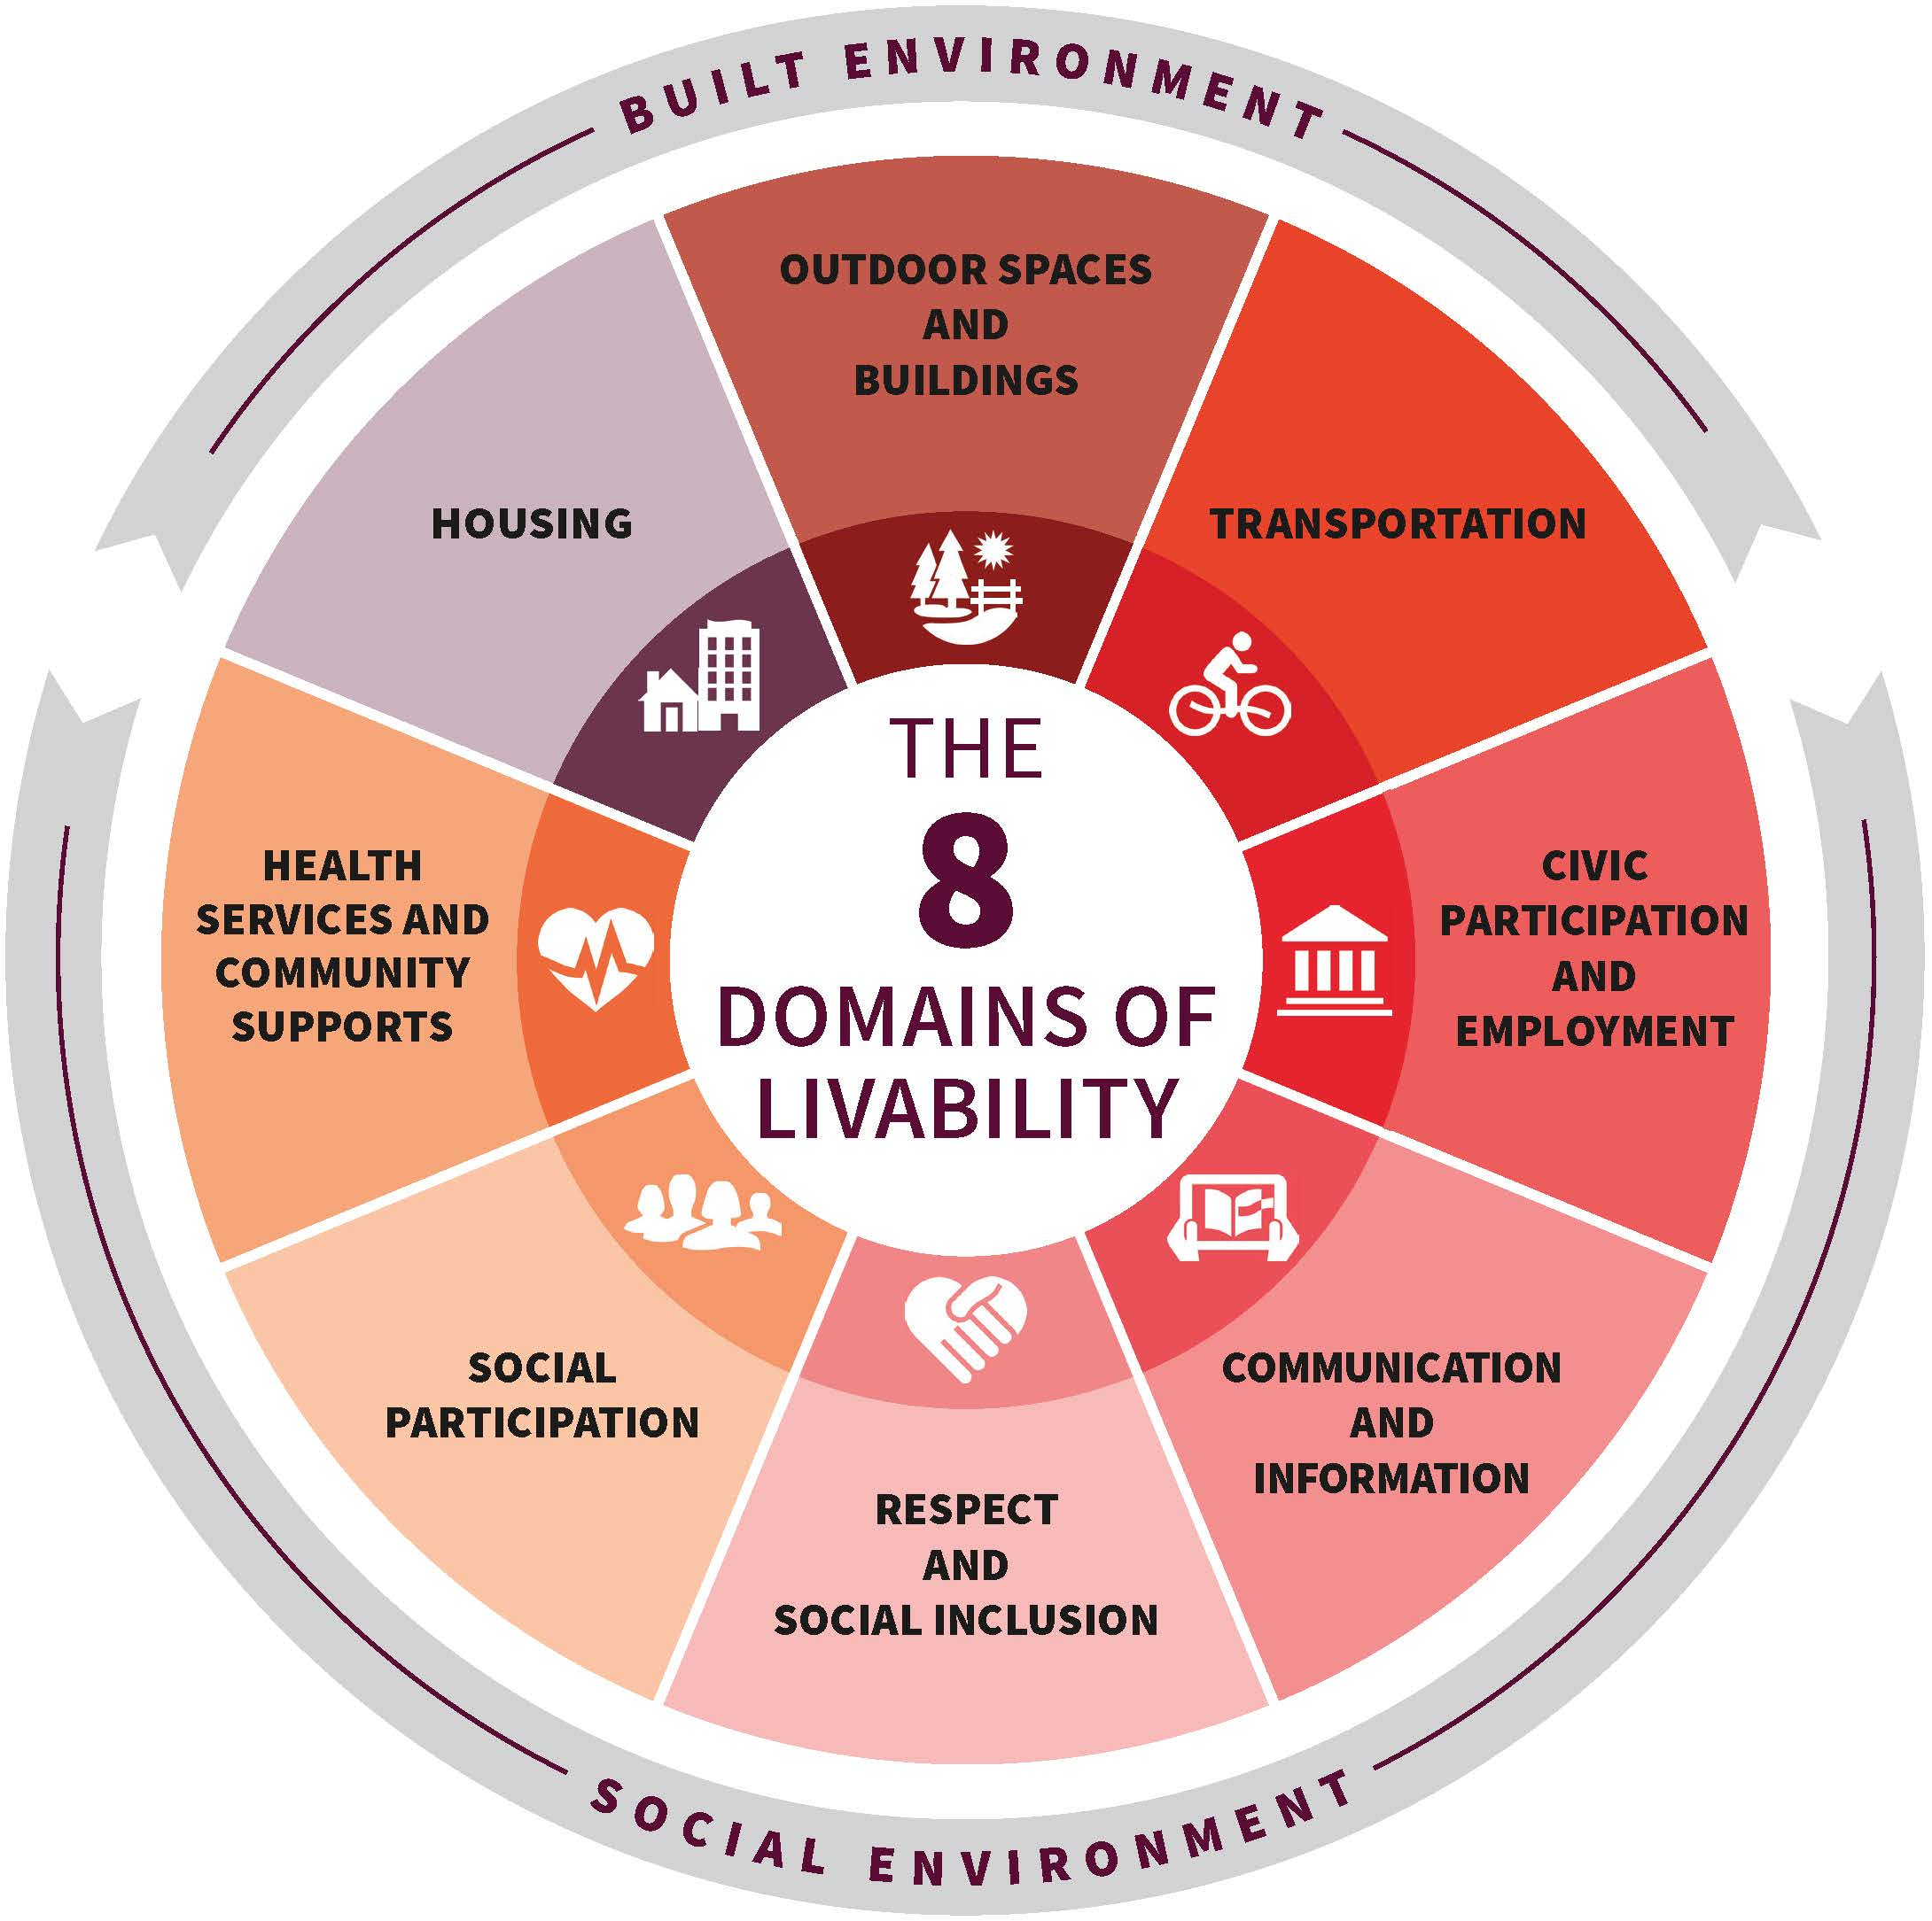
The 8 Domains of Livability
is the framework used by states and communities enrolled in the network to organize and prioritize their work to become more livable for both older residents and people of all ages.
The availability and quality of these community features impact the well-being of older adults.

Slide 11








The 8 Domains of Livability
AARP Network of Age-Friendly States and Communities
Outdoor Spaces & Buildings
Respect & Social Inclusion
The availability and quality of these community features impact the well-being of older adults—and help make communities more livable for people of all ages.
Transportation
Social Participation
Civic Engagement & Employment
Health & Community Svcs.
Communication & Information
Housing
Notes:
Don’t forget: talk about the new Federal Funding category
Outdoor spaces – dark red (171, 33, 37)
Transportation – bright red (239, 19, 0)
Civic engagement – salmon (247, 93, 89)
Communication – salmon 2 (252, 144, 142)
Respect – pink (255, 188, 185)
Social Participation – peach (252, 197, 165)
Health – peach 2 (255, 167, 120)
Housing – maroon (92, 0, 51)

Slide 12
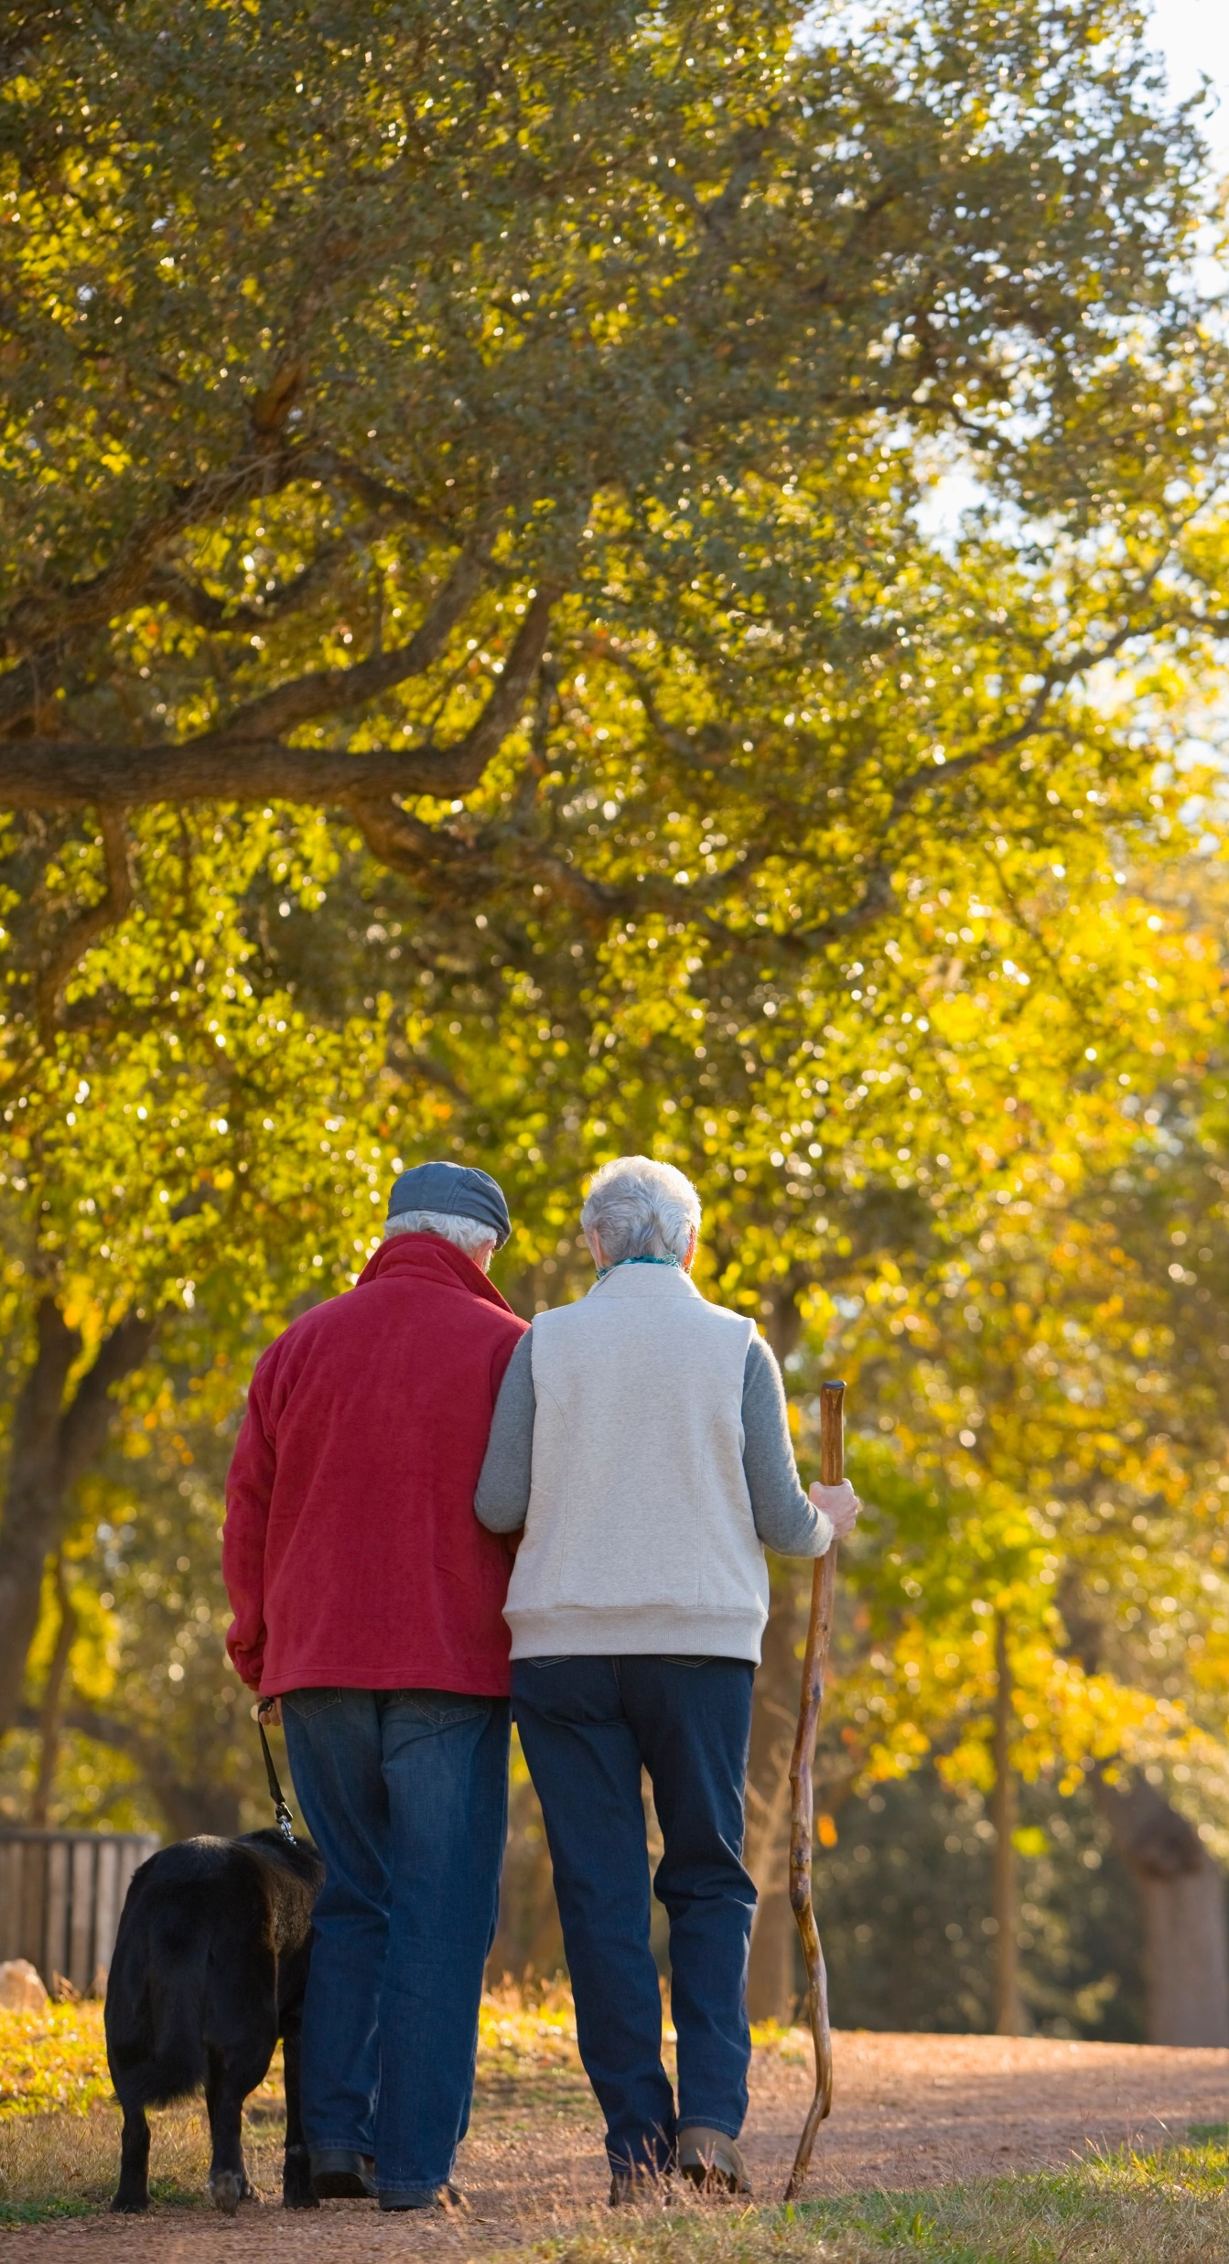

AARP Network of Age-Friendly States and Communities
People need public places to gather — indoors and out. Green spaces, seating and accessible buildings (elevators, zero-step entrances, staircases with railings) can be used and enjoyed by people of all ages
Nearly three-quarters of adults (73%) say it is important to have safe, well-lit parks that give residents places to gather and interact with friends.
Resources:
Creating Parks and Public Spaces
The Pop-up Placemaking Toolkit
The Walk Audit Toolkit
Source: AARP Home and Community preferences Survey 11/21

Slide 13
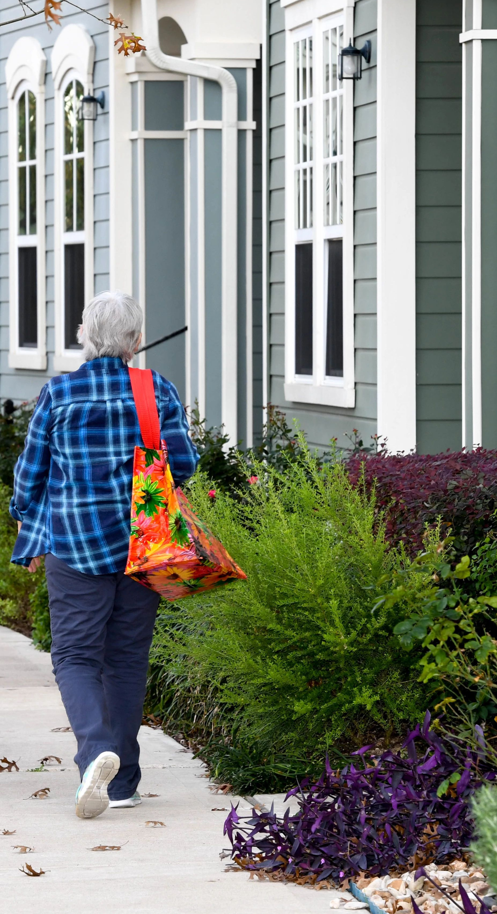

AARP Network of Age-Friendly States and Communities
We spend more time in our homes than anywhere else, so housing costs, choices, and accessibility are critical. Great communities provide housing opportunities for people of all ages, incomes, and abilities.
More than three-quarters of adults ages 50 and older want to stay in their homes (77%) and communities (79%) as they age.
Resources:
Making Room for ‘Making Room’
The ABCs of ADUs
AARP HomeFit Guide
Source: AARP Home and Community preferences Survey 11/21
Notes:
Stat: Most adults would consider leaving their current home to find one that would better enable them to age independently (all adults: 49%; 50-plus: 57%). Others would consider moving for options that:
Cost less to maintain (All adults: 44%),
Were smaller (All adults: 23%; and 50-plus: 29%), and
Were physically easier to maintain (All adults: 38%; and 50-plus: 44%)
We spend more time in our homes than anywhere else, so housing costs, choices, and accessibility are critical. Great communities provide housing opportunities for people of all ages, incomes, and abilities, allowing everyone to live in a quality neighborhood regardless of their circumstances.
More than three-quarters of adults ages 50 and older want to stay in their homes (77%) and communities (79%) as they age, one-third (33%) also report their houses would need modifications to be able to do so safely and independently.

Slide 14
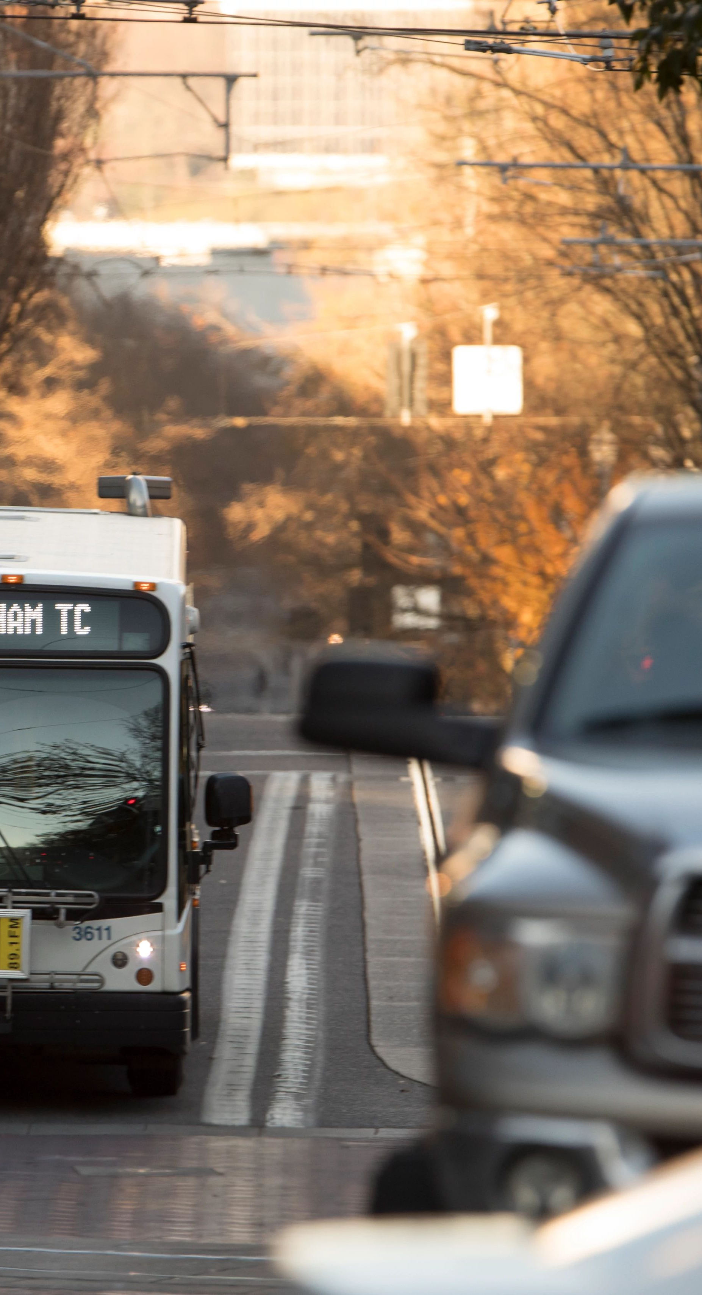

AARP Network of Age-Friendly States and Communities
Driving shouldn’t be the only way to get around. Pedestrians need sidewalks and safe, crossable streets. Moving easily and safely from one place to another vastly improves quality of life.
Well-maintained, accessible and safe streets are reported as being among the most important community features for transportation.
Resources:
Future of Transportation
Roadmap to Livability: Transportation Workbook
AARP Public Policy Institute Transportation Resources
Source: AARP Home and Community preferences Survey 11/21
Notes:
Moving easily and safely from one place to another vastly improves quality of life. Transportation options that connect people to social activities, jobs, and medical care, and offer convenient, healthy, accessible, and low-cost alternatives to driving are paramount to supporting all community members.

Slide 15
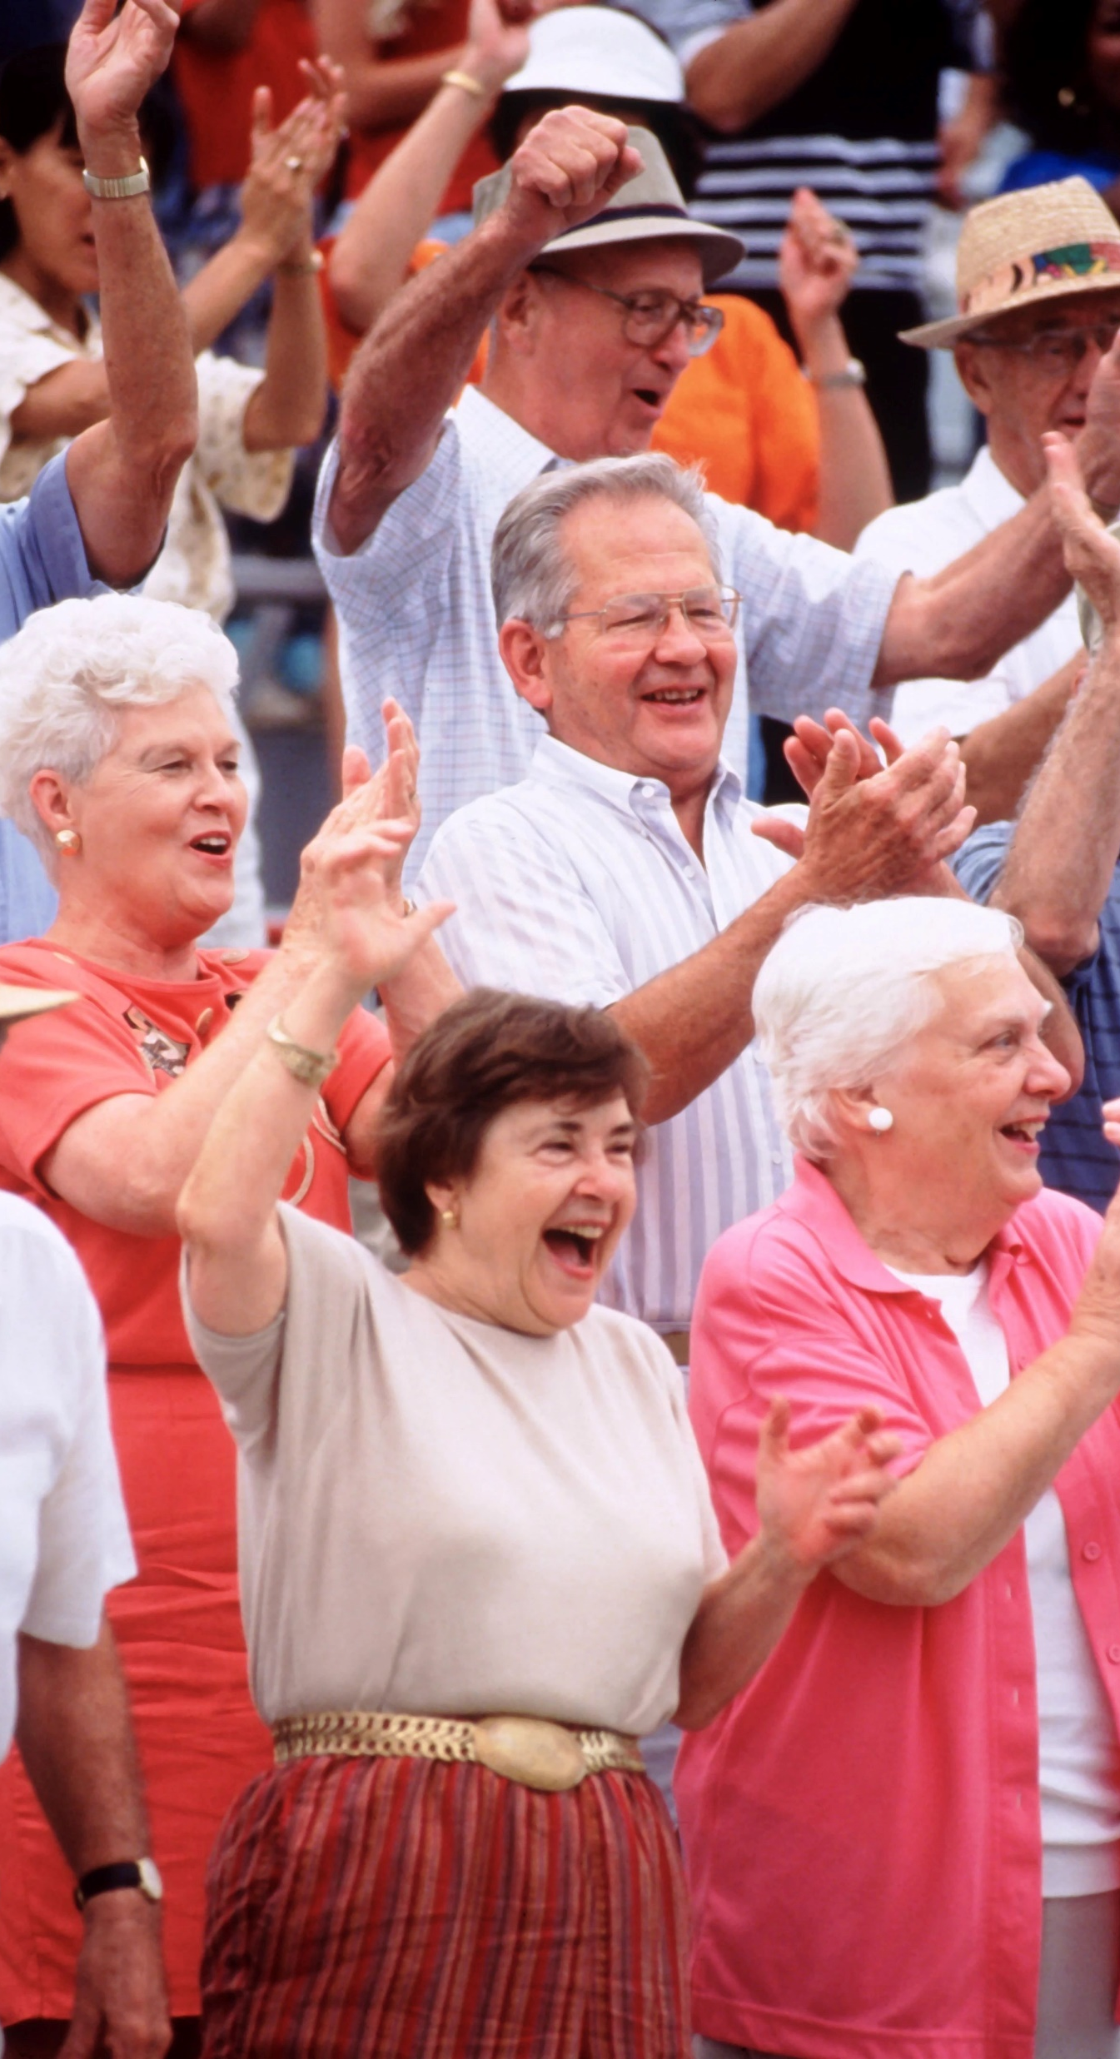

AARP Network of Age-Friendly States and Communities
Participating in social activities makes people feel as if they matter to a community, which provides a sense of meaning and belonging. Social activities can help relieve the angst of perceived social isolation.
Top predictors of loneliness: size and diversity of an individual’s social network and being physically isolated. Other contributing factors include age, depression, urbanicity, anxiety and overall health
Resources:
Engaging the Community Creates Community
Age-Friendly and Accessible Event Guide (Cleveland, OH)
Community Guide to Accessible Events and Meetings (Seattle, WA)
Source: Loneliness and Social Connections: A National Survey of Adults 45 and Older, 2018
Notes:
Moving easily and safely from one place to another vastly improves quality of life. Transportation options that connect people to social activities, jobs, and medical care, and offer convenient, healthy, accessible, and low-cost alternatives to driving are paramount to supporting all community members.

Slide 16


AARP Network of Age-Friendly States and Communities
Everyone wants to feel valued. Socially inclusive gatherings and activities are a great way for people to learn from one another, honor what each has to offer and, at the same time, feel good about themselves.
A strong majority (71%) of adults ages 50+ believe it’s important for their community to treat all residents equally regardless of race, gender, age, ethnic background, sexual orientation, or other differences.
Resources:
Disrupt Aging
Equity By Design
Source: AARP Home and Community preferences Survey 11/21
Notes:
Moving easily and safely from one place to another vastly improves quality of life. Transportation options that connect people to social activities, jobs, and medical care, and offer convenient, healthy, accessible, and low-cost alternatives to driving are paramount to supporting all community members.

Slide 17


AARP Network of Age-Friendly States and Communities
Why does work need to be an all or nothing experience? An age-friendly community encourages older people to be actively engaged in community life and has opportunities for residents to work for pay or volunteer their skills.
Holding a perception that one can make a difference on problems that exist in their community is a top predictor of 50+ civic engagement.
Resources:
Create the Good
AARP Employer Pledge Program
Source: Connecting, Serving, and Giving: Civic Engagement Among Mid-Life and Older Adults, 2019
Notes:
Moving easily and safely from one place to another vastly improves quality of life. Transportation options that connect people to social activities, jobs, and medical care, and offer convenient, healthy, accessible, and low-cost alternatives to driving are paramount to supporting all community members.

Slide 18


AARP Network of Age-Friendly States and Communities
Age-friendly communities recognize that information needs to be shared through a variety of methods since not everyone is tech-savvy, and not everyone has a smartphone or home-based access to the internet.
76% of adults age 50-plus place high importance on having access to reliable and affordable in-home high-speed Internet.
Resources:
Roadmap to Livability: Community Listening Toolkit
Exploring Digital Equity Fact Sheet Series
AARP Free E-Newsletters
Source: AARP Home and Community preferences Survey 11/21
Notes:
Moving easily and safely from one place to another vastly improves quality of life. Transportation options that connect people to social activities, jobs, and medical care, and offer convenient, healthy, accessible, and low-cost alternatives to driving are paramount to supporting all community members.

Slide 19
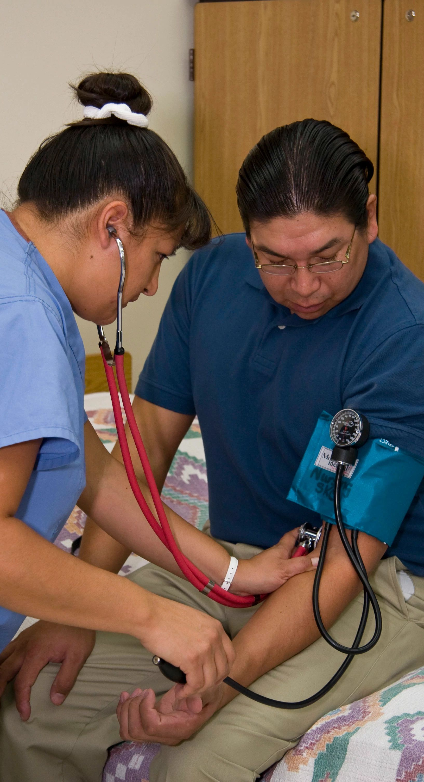

AARP Network of Age-Friendly States and Communities
Community support is strongly connected to good health and well-being throughout life, alongside accessible and affordable health care services, which are vital for maintaining health and independence.
U.S. adults age 45+ think many healthcare issues are important: staying mentally sharp (96%), staying physically healthy (92%), having adequate health insurance coverage (91%)
Resources:
RTL: Health Services and Community Supports Workbook
AARP Prepare to Care Guide
Source: Vital Voices: Issues that impact U.S. Adults Age 45 and Older; 9/2021

Slide 20
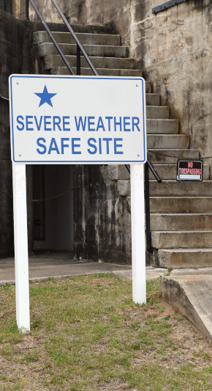

AARP Network of Age-Friendly States and Communities
Community planning plays a vital role in reducing the long-term risks to life and property from natural hazards such as hurricanes, earthquakes, wildfires, and floods.
Adults aged 65 and older are a growing demographic who are often disproportionately impacted by severe weather.
Resources:
AARP Disaster Resilience Toolkit
Guide to Expanding Mitigation
Wildfire Home Retrofit Guide
Source: AARP Disaster Resilience Toolkit
Notes:
Moving easily and safely from one place to another vastly improves quality of life. Transportation options that connect people to social activities, jobs, and medical care, and offer convenient, healthy, accessible, and low-cost alternatives to driving are paramount to supporting all community members.

Slide 21
How Age-Friendly do you think your community is?
Take a self-assessment. Rank your community on a scale of
1-10 on each of the domains of livability:
Domain | Score
Housing
Outdoor Spaces and Buildings
Transportation
Civic Participation/Employment Opportunities
Communication and Information
Respect and Social Inclusion
Social Participation
Health Services and Community Supports
Notes:
How Age-Friendly do you think your community is?
Take a self-assessment. Rank your community on a scale of 1-10 on each of the domains of livability:
Housing
Transportation
Outdoor Spaces and Buildings
Community Supports and Health Services,
Communication and Information
Civic Participation/Employment Opportunities
Social Participation
Respect and Social Inclusion

Slide 22
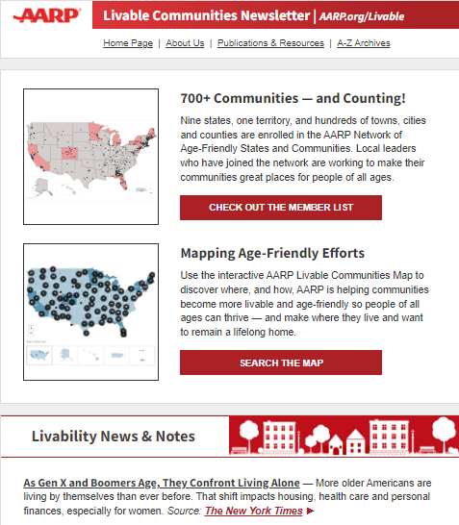
Resources
AARP LIVABLE COMMUNITIES
Tools to help local leaders
Livable Communities Landing Page:
aarp.org/livable
Livable Communities Newsletter:
aarp.org/livable-newsletter
Livable Communities Map:
livablemap.aarp.org
Community Challenge Grant Program:
aarp.org/communitychallenge
20+ Free Publications:
aarp.org/livablelibrary
| Pictured: Livable Newsletter (Dec. 14, 2022)
Notes:
AARP offers more than 20 free publications via download and print to support local leaders create better housing, transportation and public spaces.
Our weekly newsletter reaches more than 100,000 local leaders; sign up for weekly updates from AARP on all-things-livable by texting LIVABLE to 50757.
Learn more about our Community Challenge grant program via aarp.org/livable or aarp.org/CommunityChallenge OR by searching our interactive map (livablemap.aarp.org) where you can find past grantees, search by topic, and much more.

