Slide 1


SREC PROJECT UPDATE
JUNEAU ECONOMIC DEVELOPMENT COUNCIL
Tonya Muldoon, SREC Program Director
Website Project Update
January 2025

Slide 2

Organizational Headlines or Changes to Share
July-December 2024, additional Steering Committee members joined:
  Nikki Bass, Co-Owner of Tides LLC,
  Gloria Burns Vice President Ketchikan Indian Community, and
  Wayne Stevens, retired (former United Way Southeast Director and State Chamber Director)
  John Smith III, T&H Elder Council member, Community Elder Advocate
November 2024, 114 SREC members
December 2024, Nikki Bass, resigned from the Steering Committee

Slide 3

Summary of Project Progress

Slide 4
SREC Coalition Engagement
Coalition meets monthly on the first Friday of each month. Discuss SREC Project, regional and community events, best practice sharing with a statewide agency or program.
  Sub-Committees formed:
    Advocacy Committee
    Navi Tool Committee
Steering Committee (SC) meets monthly
Currently have eight Steering Committee members active with the Coalition
Webpage for SREC updated monthly with notes, community events.
Teal St Office, Centralized location in Juneau that houses community and regional non-profit agencies to support vulnerable populations. Staffed weekly and by appointment. Grand opening July 18, 2024. See Changes

Slide 5
Eldercare Summit a Huge Success!
Organized SREC Summit October 1-2, 2024, with pre-conference training September 30, 2024.
  Pre-conference training provided:
  American Heart Association Basic Life Support Instructor training
  HeartSaver and HeartCode American Heart CPR and First Aid Hybrid
  Mental Health first Aid for Older Persons (In-Kind Training from SERRC Path Academy staff)
  Medication Management for non-medical providers
  Catholic Community Service Staff In-Service training
  Over 34 presenters
  20 Venders
  Job fair vendors were available with free access from the community.
  209 participants overall
  Travel support to 30 regional community members / provider participants to travel Juneau
  Promo used for Full Conference tickets for 173 participants and 2 Senior Admissions with escorts; 1 , 2-Day General Admission; 3, 1 –Day General Admissions;

Slide 6
Feedback from the Eldercare Summit
11 new SREC members joined the Coalition
    Summit Participant Survey Feedback:
    How participants’ felt: Using a Likert Scale: 1 Missed the Mark – 5 Excellent
    Summit Organization: Avg 4.5
    Mix of topics and quality of presentations: Avg 4.5
    Would like to attend another Regional Summit: Using a Likert Scale: 1 Not interested, 3 Might attend, 5 For Sure
    Avg 4.8 – for sure would attend a future Summit

Slide 8
Navigation through Senior Center Network
Senior Centers Technology
Ten Neat systems regionally have been ordered and beginning to be delivered to sites. Final ETA January 2025.
Senior Center Referral/Navigation Training:
  Senior Center staff attended the SREC Summit. Marks the first time in 15 years CCS regional staff have had a face-to-face meeting.
  Conducted initial My Senior Center training for data collection process.
  Review of Registration document for data collection. Training in development.
  CPR/first Aid Training for staff
  Developing Navigational Referral training
  Relais Platform Training established for staff to utilize.
Data Collection
To be collected through Senior Center Registration document
Regional Elder Care Survey, Spring 2025
Catholic Community Service (CCS) has posted three positions to support the project
  Hired, but not retained - New Operations Manager
  JV Activities position has been recruited.
  Pending Activities/Cook
Navi Tool in development. Researching Environmental Modification, Entrepreneurship Toolkit, and Training Pathways. Hoping to try to obtain additional feedback from providers in January.

Slide 9
Training Development
CNA:
July 22, 2024: Meeting conducted with local and regional providers regarding the loss of UAS’s CNA course at the Juneau campus. Explored the regional resources available to determine a collaborative model to provide stability to the educational program.
Oct 16, 2024: Meeting conducted with UAS Chancellor’s Office, Juneau Community Foundation, and SREC about coordinating resources to determine sustainability of the CNA program in Juneau. Chancellor scheduled a follow-up meeting with regional CEOs to discuss possible collaborative actions.
November 7, 2024: UAS has created a model of delivery to provide a CNA course as a split course. The classroom education (6-credit) will be offered through UAS Sitka Campus virtually with an adjunct professor in Juneau to provide Lab and Practical education (3-credit). Bartlett Regional Hospital will act as the practical site. UAS has created a draft document to seek sponsorships for the course. Aiming for course delivery for Spring 2025. SREC is working with Juneau Community Fund regarding ongoing funding requesting.

Slide 10
Training Delivered to Direct Care Workers
University of Alaska
  Direct Support Professional Training: DSDS Certification. May–June 2024 3-Credit course delivered on-line and with hands-on instruction in Sitka, Alaska. Approved by the State of Alaska. Pilot course had eight graduating students. SREC supported students with tuition, travel, and books.
    Pending review by UAS facility for addition to course manual, 2025.
  Attempted to include and encourage APCA to participate in discussions and delivery of support to students. They have been a very challenging partners to work with.
  Understanding Dementia Course development funded. 1-Credit course on-line delivered through Ketchikan UAS in August 2024. 11 students attended the course. Student requests have led to course being offered again for Winter Semester 2025.
PATH Academy: MOA provide for funding support for food insecurity for students while in class.
  Provided support for Mock Interviewing
  In-Kind SERRC provided Mental Health First Aid for Seniors at Summit.

Slide 11
Aging in Place, leverage resources
Environmental Modifications
  Identified 197 regional residential contractors.
  State of Alaska is modifying the Environmental Modification program. The allowable rates for services have increased from $18,500 to $40,000 per three-year cycle however this is not yet reflected in regulations. Once SOA can determine delivery of program, future collaboration will be conducted with residential contractors likely by survey and/or community meeting.
    Information collected will also be utilized for entry into the Navi Tool for contractor services. Home repair and handymen are highly sot after services in the region for residents who would like to age in place.
  November 20, 2024: Registered to participate in the State e-mod program training scheduled for November 20 to review status of program. DSDS has ARPA funding that they are extending for facility-based modifications.
  SREC is continuing to collaborate with SAIL.

Slide 12
Outreach
Job Fairs in the region tend to not be well advertised and often are targeted at small focus groups, such as students. SREC staff have developed a list of regional fairs and will be coordinating with coalition members about the resource. SREC did provide a job fair at the SREC Summit October 2024.
Resource Fair Exploring ideas for resource fairs in Ketchikan and Sitka. Goal is a resource fair in Sitka, Alaska in Spring 2025 and Ketchikan in Fall 2025. Also exploring options for a second Juneau Summit, in 2026.
Southeast Alaska Eldercare Survey, conducted survey June-Oct 2024 of regional eldercare providers regarding the status of the workforce and current needs.

Slide 13
Rate Review
Rate Review: SREC members have met several times with Sandra Heffern, regarding conducting a private Medicaid rate review to determine the feasibility of providers to offer Personal Care Services especially for business development. Some agencies involved are conducting a concurrent SOA rate review of total services. The proposal is still being negotiated.

Slide 14
Any Surprises or Learnings to Date

Slide 15
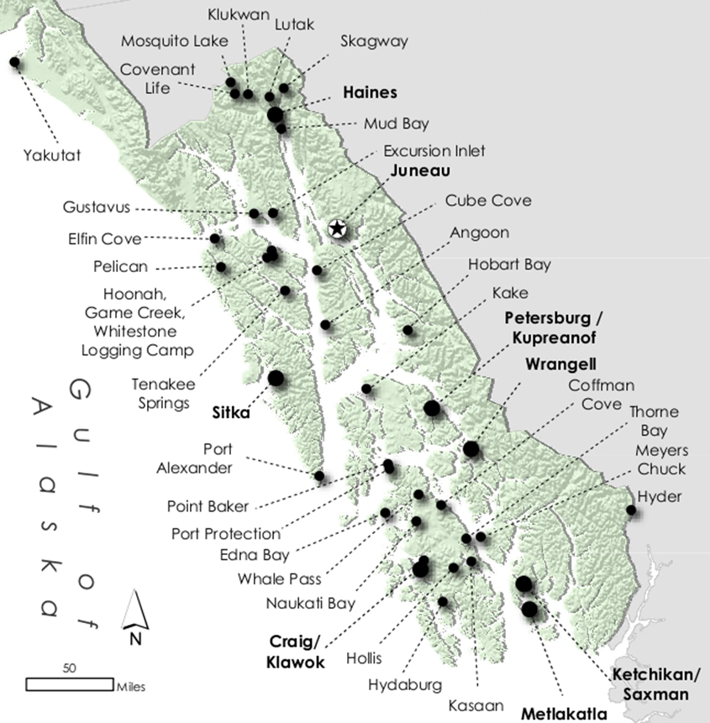
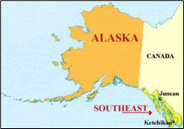
Hearing from the Facilities
Southeast Alaska Eldercare Survey, SREC conducted a workforce needs survey June-Oct 2024 of regional eldercare providers.
  Responses received from 16 agencies Assisted Living Home (7), Skilled Nursing Home (3), Home Health Care (4), and in-home care agency providers (2) located in Juneau, Haines, Metlakatla, Ketchikan, Petersburg, Sitka and Wrangell.
  .

Slide 16
The Workforce Demand is Relentless
  62% of providers are providing the same level of care as they did 2 years ago, 25% are providing more options.
  78% reported a decrease in the number of employees in the last 2 years.
100% of providers rated the market for in-home care services as, in severe need and demand.
100% reported having trouble attracting and securing staff.
100% of providers responded that they require more employees to support senior aging in place.
(JEDC, Southeast Alaska Eldercare Survey 2024)

Slide 17


For Everyone Served, Someone is Awaiting Help
Currently there are 264+ reported seniors being served by Eldercare providers who responded to the survey
Reported number of seniors on active waiting list (August 2024) for Eldercare support: 256 people
(JEDC, Southeast Alaska Eldercare Survey 2024)
Notes:
Being served and waiting to be served are almost equal = The workforce ought to grow by 50% to serve all. The home care agencies however are conducting a one-to-one hiring practice which will not support the growing need for in-home care workers. We are working to better understand the level of need in the region through the data collection with CCS. We are hopeful to obtain a list of accrual individuals in need of additional support.

Slide 18
Where’s the Quality of Life?
When a Third Could Go Home
Reported number of facility residents
  Level III (up to 24- hour regular care): 96+ people
  Level IV (up to 24-hour frequent care): 42+ people
  Memory Care: 81+ people
Reported number of seniors in facility level care that believed could manage in the community if in-home services were available: 60 people
(JEDC, Southeast Alaska Eldercare Survey 2024)
Notes:
This is a snap-shot from those who responded to the survey. A bed count for all services in the region would result in higher numbers, however the reflection that about 1/3 of facility residents could return home if they had in-home care available is actuate. A consist trend in placement in the region has been that due to lacking in home care people are forced to seek placement to have their needs meet. Rarely, do theses residents return home. They will often move between facilities.

Slide 19
How is the Caregiver Supported?
Percentage of Eldercare Providers providing Employee Benefits to Caregivers (excluding administrators) (JEDC, Southeast Alaska Eldercare Survey 2024)
Notes:
DSP homecare agencies reported that they provide benefits to administrative staff and often not to the caregivers due to costs and most are working part-time or less. The facility caregivers however tend to be full-time employees, and the facilities are providing full benefit packages.

Slide 20
Workforce Speaks of needed Growth
Providers perspective that their community would benefit from having additional non-profit and for-profit eldercare services
  Community Based Services 56%
  In-home Care 67%
  Independent Living Home 33%
  Assisted living Home 22%
  Does not require additional eldercare services 11%
(JEDC, Southeast Alaska Eldercare Survey2024)

Slide 21
Which Career Would you Choose?
Elder Care DSP Workforce
Tourism Workforce
Residency: 100% Local
Wages: $16-24, Mean $18
Revenue: Medicaid Rate Based Fixed (majority non-profit)
Gender: More female
Ages: Avg. 40+ years old
  Tends to be second job, Part-time, annual employment
Motivation: Care for family or friend
Challenges: Cost of Living and Affordable Housing
Residency: 57% Local
Wages: $17-27, Mean $21
Revenue: Sales/Fee for Service Based (majority for-profit)
Gender: More male
Ages: Mean 30 years old
74% repeat seasonal work, Full-time
Motivation: Adventure and unique work experience
Challenges: Cost of Living and Affordable Housing
(JEDC DSP Survey 2024)
(JEDC Seasonal Worker Survey 2024)
Notes:
Learned previously that employees would leave for Tourism jobs during the summer months instead of remaining employment with the Eldercare agencies. Tourism pays a slightly higher hourly rate. Slightly younger workforce for tourism than Eldercare. All agency’s have raised their wages since the onset of the SREC Project however even with a raise in wages the wages still do not fully equal the tourism positions.

Slide 22
We Have the Resources to Work Together,
Breaking Down the Silos
UAS CNA Course Matrix | UAS JNU | UAS KTN | UAS SIK | BRH | RSL | SEARHC | APCA | T&H | DOL | DVR | TVR | Local Schools | Local Gov
Access to students | x | x | x |  |  |  | x | x | x | x | x | x
Access to workforce development employees |  |  |  | x | x | x
Community offer Course |  | x | x
Internal CNA Course = Employment |  |  |  | x |  | x
Staff Instructor |  | x | x | x |  | x
Funding Instructor(Internal) |  |  |  | x |  | x
Funding Instructor |  | State $ City | State $ City
Funding Tuition |  |  |  |  |  |  | x | x | x | x | x
CNA Class Location by provider |  | KTN POW Haines | STK | JNU |  | WRG PGS
Media Outreach |  |  |  |  | x |  | x | x | x | x | x | x
Certification Location | x
Practicum Sites |  | x |  | x |  | x
College Credit | x | x | x
Student Housing | x |  |  |  | x
Funding for short term student housing |  |  |  |  |  |  | x | x | x | x | x

Slide 23
Sustainability: Provide the Needed Education
November 7, 2024, UAS Meeting:
Provider Resources
Sitka UAS Campus 6 Credit Virtual Classroom
Vested full-time staff member
Juneau UAS Campus 3 Credit Lab/Practical
Adjunct Professor
Bartlett Regional Hospital Wildflower Court Practical Site
For sustainability, it was determined that UAS could seek sponsorship for the cost of the professor resulting in tuition rates to be reduced so that the course could be accessible to more students with minimal tuition costs ($25-100 per student).
UAS has created a draft document to seek sponsorships for the course.
UAS would like to delivery the course in Spring 2025.
20 student max for course
*Additional Marketability/sponsorship: CNA course could be utilized as educational base for Direct Support Professional supervisors of Personal Care Services. UAS would need to offer students SDS Exam and skills check.
SREC is asking UAS to consider a regional delivery to students to all SE Alaska communities.
Notes:
* Info was obtained following this meeting.

Slide 24
Project Changes

Slide 25
Project Changes
December 2023
November 2024
Developing plan for a resource fair in Sitka, Spring 2025 and Ketchikan, Fall 2025. Respondents have requested a second Summit event to occur, possibility 2026.
Regional Eldercare Summit

Slide 26
Project Changes
June 2024
November 2024
December 2023
Teal Street
One stop for Training, Navigation, and workforce development
The office has not been an attractant for the community for the project. In leu of being a good steward of the grant funding. We have closed the Teal St office. We will have ongoing access to the conference room and floating desks as needed to coordinate with community members in the building. We have an accessible access in our JEDC office in downtown. The JEDC staff can be mobile within Juneau and meet people in other locations. We can also assist by phone.
  SREC Project staff have been manning weekly the Teal St office. Collaboration has benefited from having staff presence in the building, however the intent was that the office would support a navigator of services from the original design of the project. Navigation has changed to CCS Senior Centers.

Slide 27
SREC Outcomes
Improved access and awareness of Eldercare resources and services through workforce development, retention, and navigation
Administration of SREC Coalition
Increased Workforce
Summit
Improved Quality Life for Elders
Financial Incentives
Improved Retention
NAVI Tool
SREC Project
Relias, UAS, and PATH Training
Improved Leadership
Entrepreneurship Toolkit
Environmental Modifications
Improved Staff Support
Senior Centers
Video Technology
Navigation + Elder Driven Activities
Regional Data Collection
Improved Autonomy and Dignity
Resource/job Fairs
Notes:
Excludes Youth Camps, Teal Street Office, Summit has been completed.

