Slide 1


SREC PROJECT UPDATE
JUNEAU ECONOMIC DEVELOPMENT COUNCIL
Tonya Muldoon, SREC Program Director
Project Update
July 2025

Slide 2


Organizational Headlines or Changes to Share
December 2024 to July 2025 Steering Committee member changes:
  Sioux Douglas, Community Elder resigned but remains an active member in the Coalition.
  Gloria Burns, Ketchikan Indian Community resigned.
  Nikki Bass, COE Tides LLC resigned.
  Joined Wayne Stevens, Community Member and Retired President of Alaska United Way.
  Joined John Smith III, Community Member, Tlingit and Haida Elder’s Council
  Three Steering Committee seats open
  SREC Project Staff
  Tess Rouse Resigned July 2025.
Istock.com

Slide 3

Summary of Project Progress

Slide 4

SREC Coalition Engagement
Coalition meets monthly on the first Friday of each month. Discuss SREC Project, regional and community events, discussion regarding regional concerns and ideas for solutions, and best practice sharing of agencies or programs.
  Sub-Committees formed:
    Advocacy Committee
Steering Committee (SC) meets monthly
Currently have seven Steering Committee members active with the Coalition
SREC Project staff have assumed Secretary duties for the coalition
Webpage for SREC updated monthly with notes, community events.
Increased in coalition membership since November 2024, 114 SREC members to 136 in April 2025

Slide 5
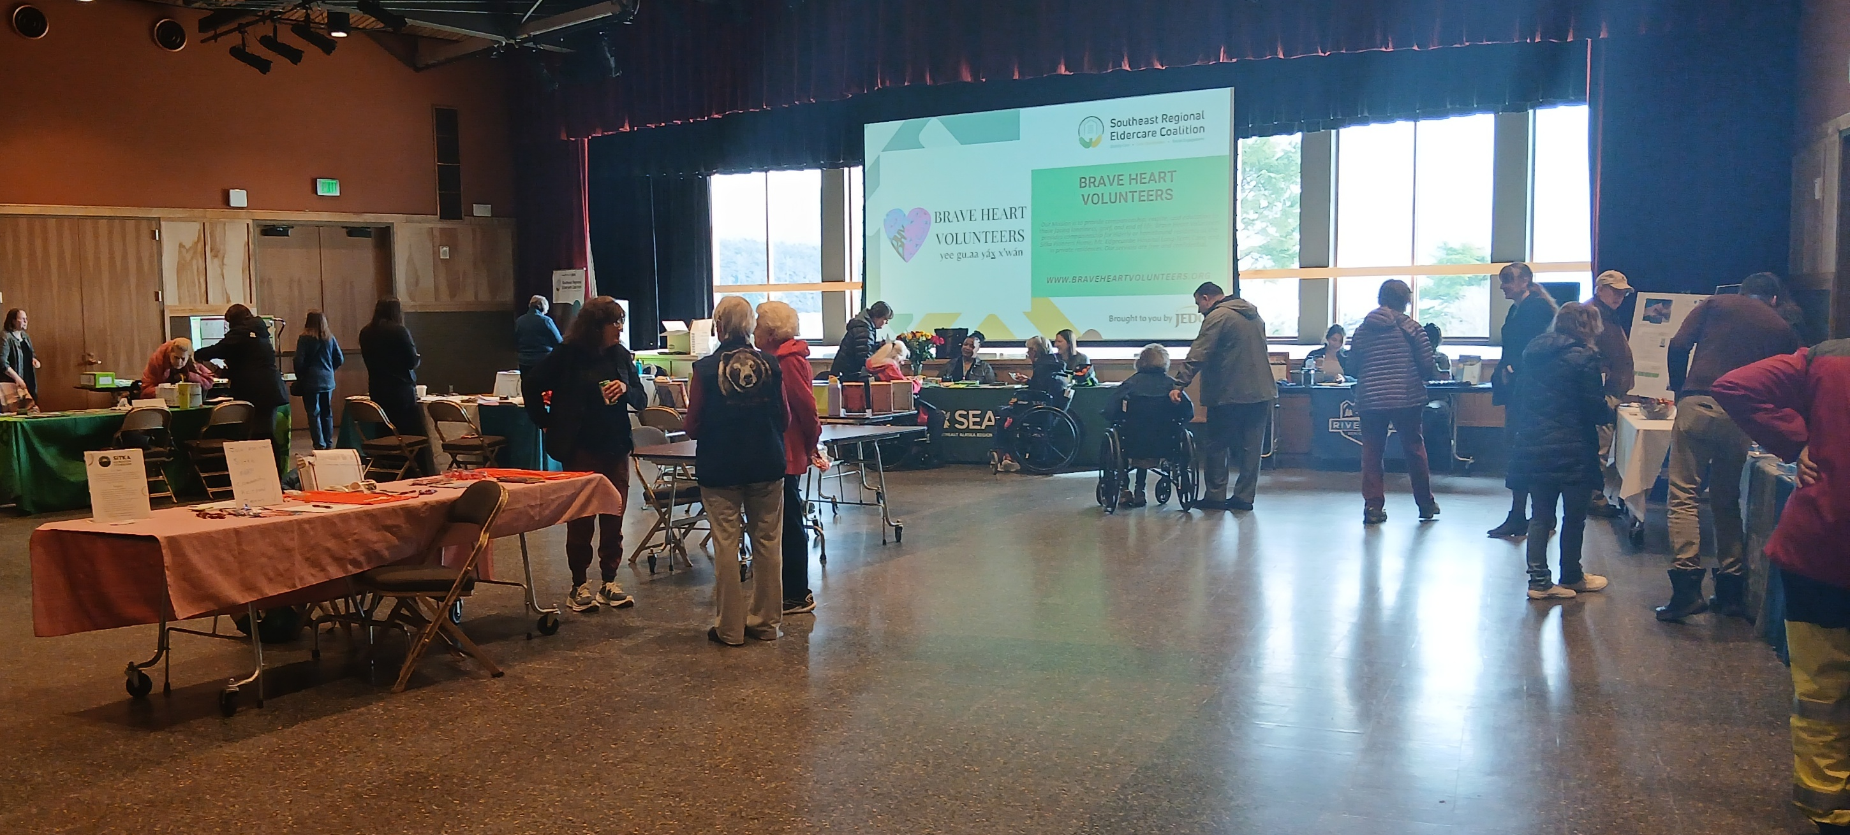
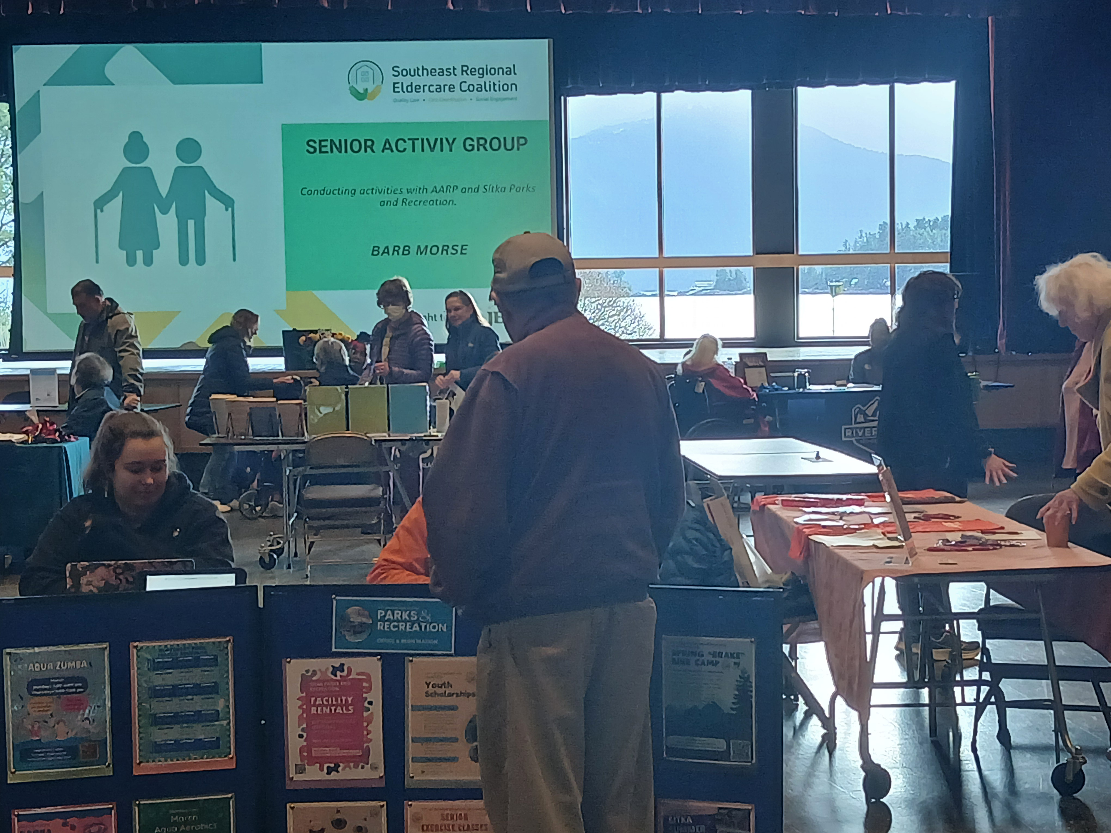
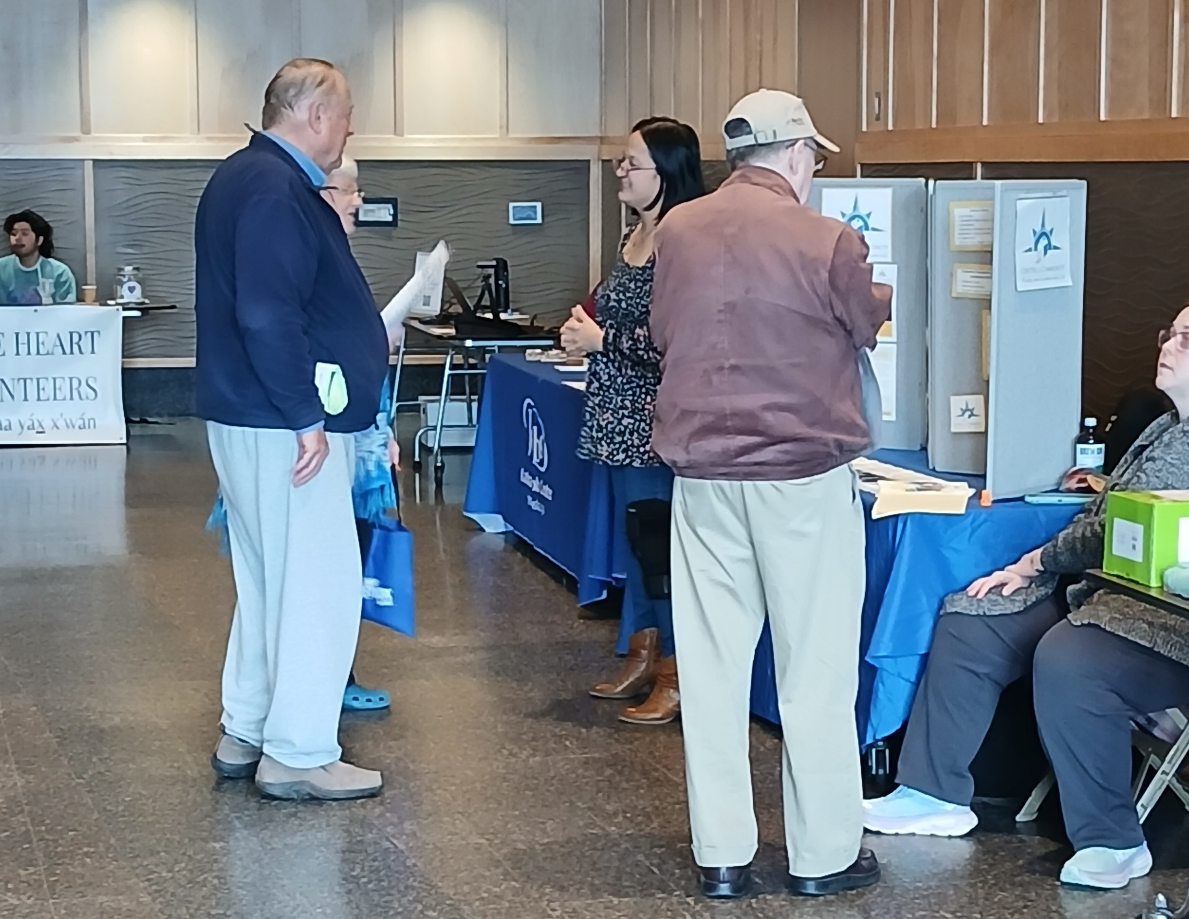
Sitka Resource Fair: Small Town Outreach, With Big Time Attendance!
Organized a Community Resource Fair in Sitka, Alaska March 6, 2025.
Partnership with Sitka Tribe of Alaska’s Elder Coffee Hour program and the City and Borough of Sitka Department of Parks and Recreation.
Free community event open to the public
Elder Coffee Hour provided lunch of halibut chowder, herring eggs, fresh rolls, salad, and peanut butter cookies
22 Vendors Tables
5 vendor tables from outside of Sitka (with 9 traveling staff)
95 Elders in attendance

Slide 6
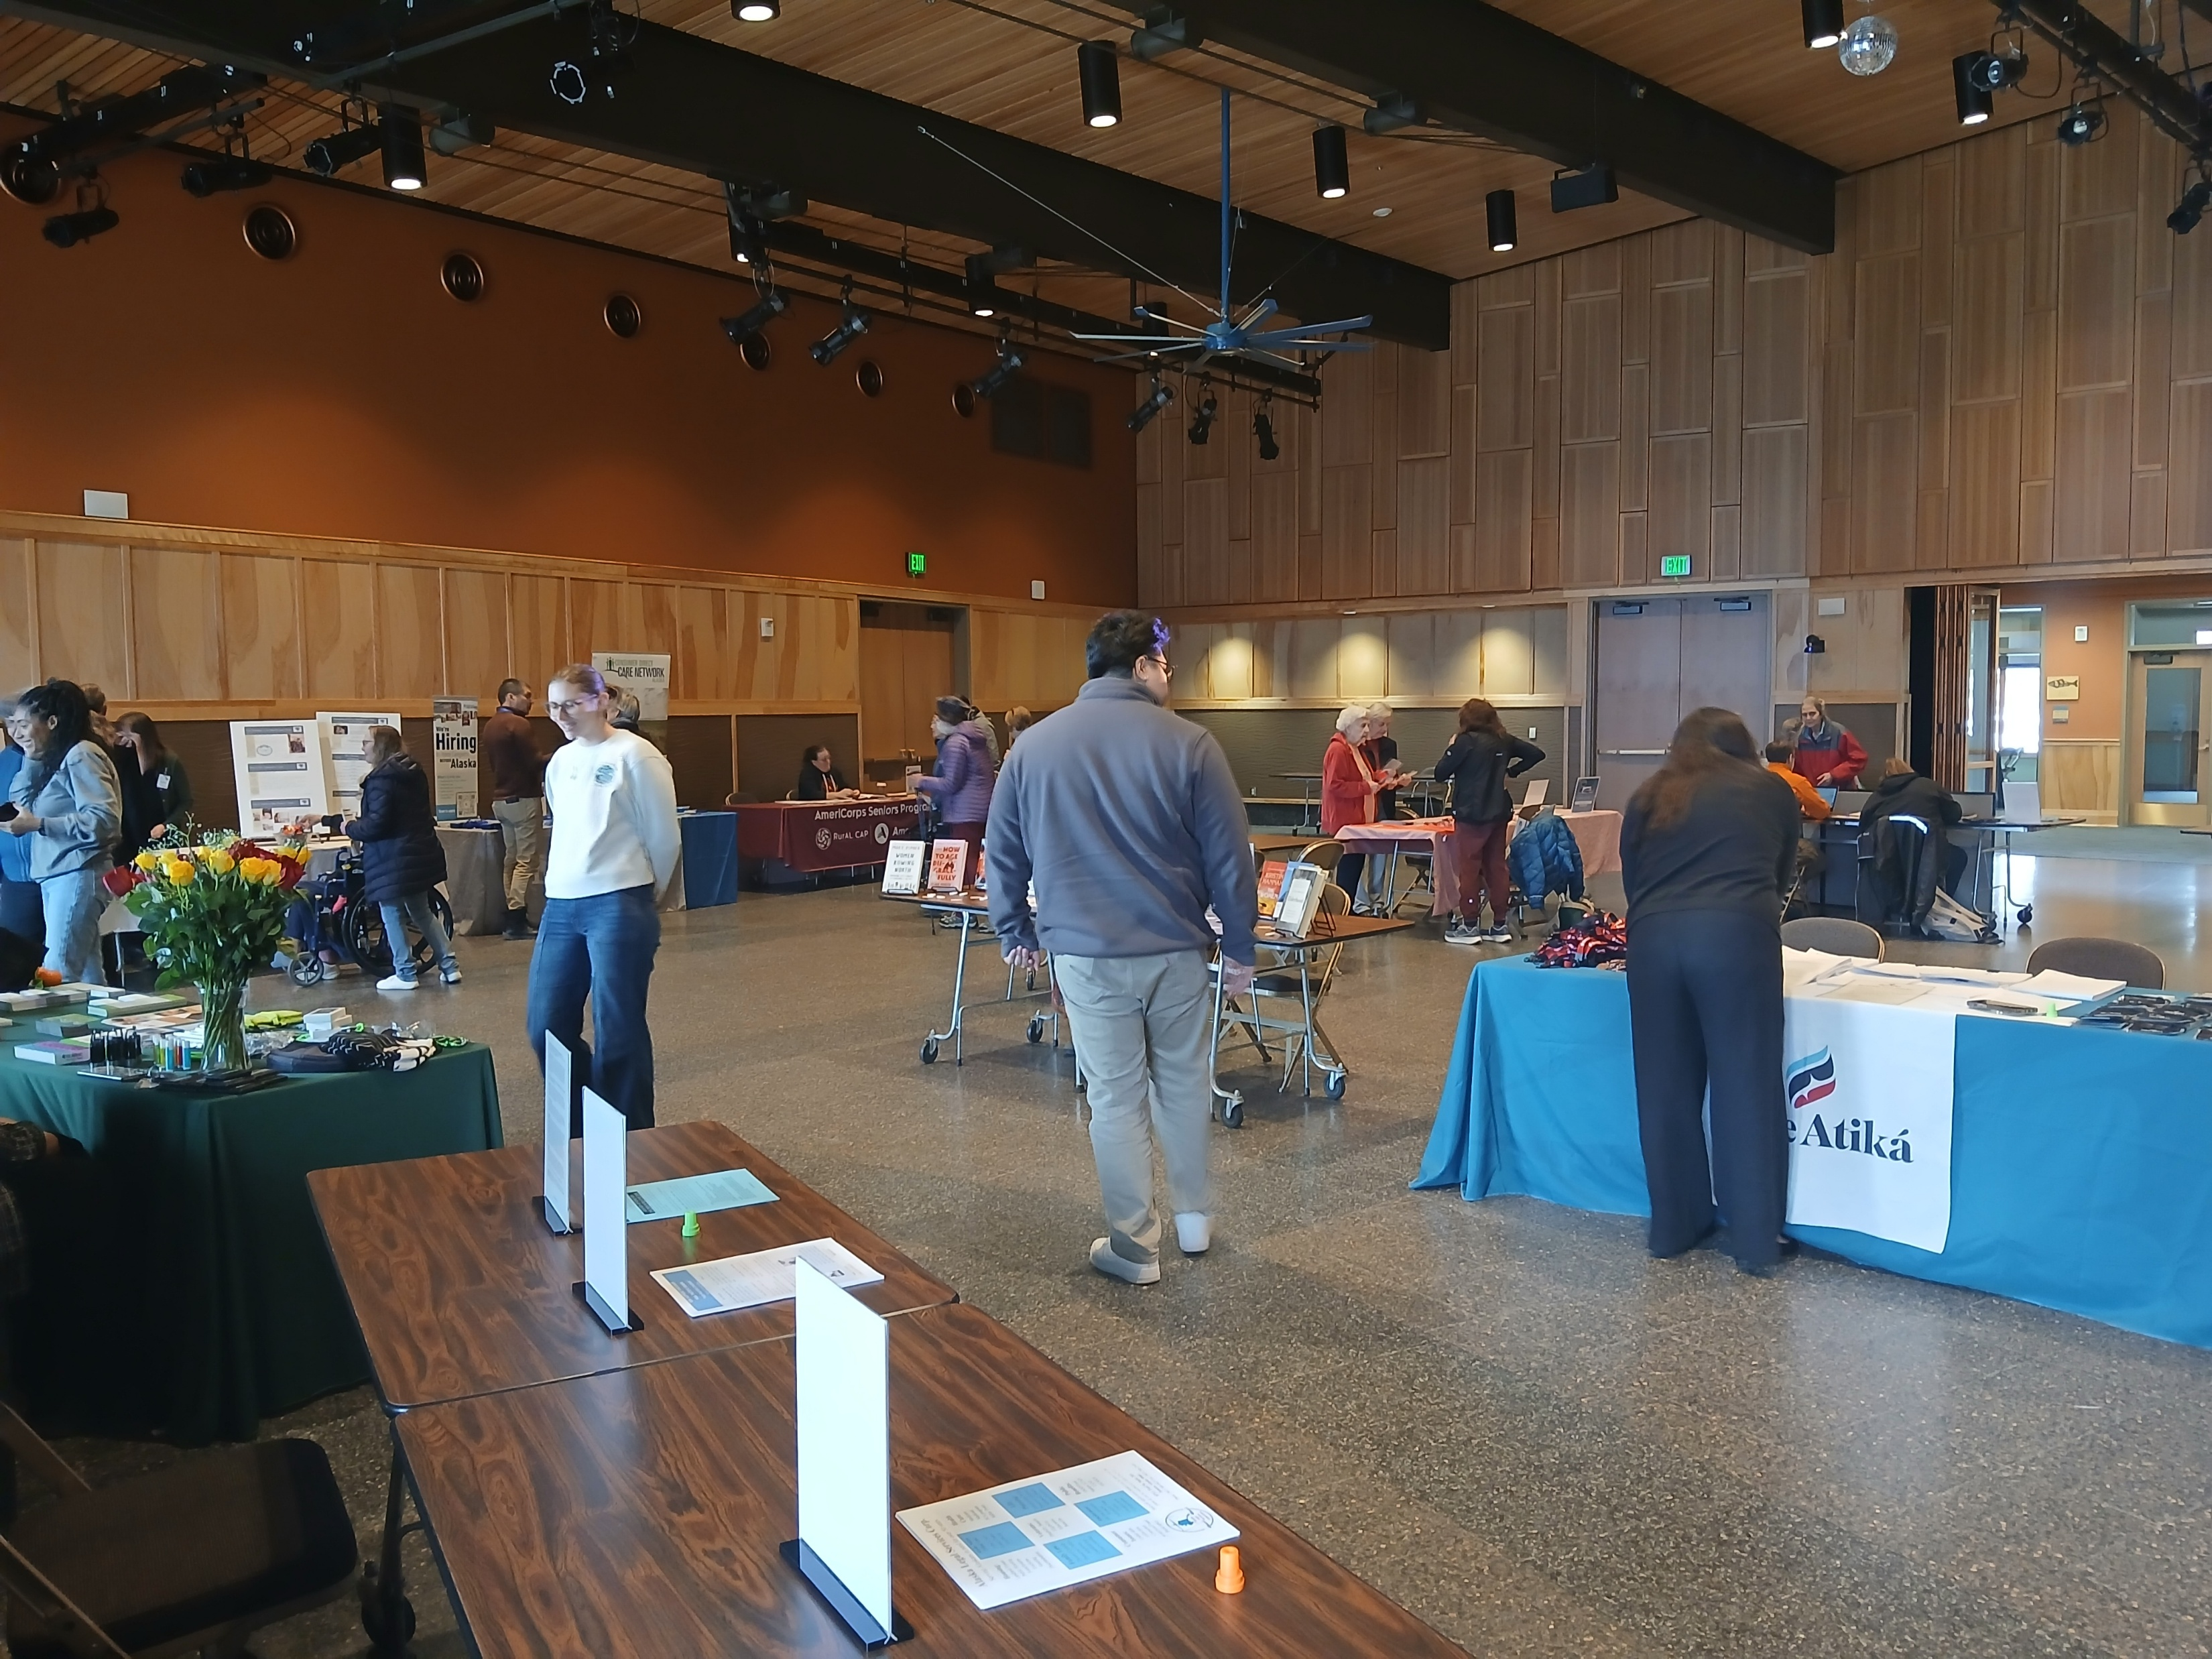
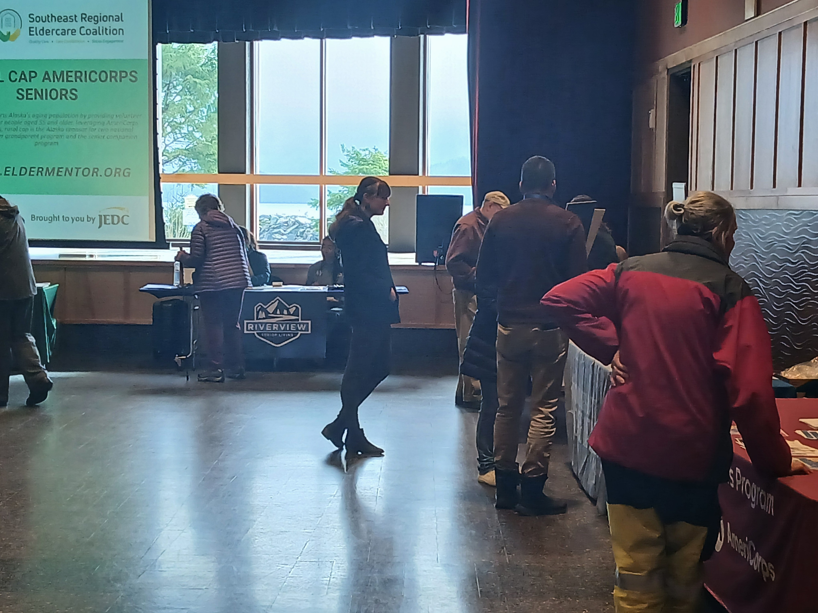
Feedback from the Sitka Elders
8% of responding elders expressed currenting having an in-home care giver
8% of responding elders expressed looking for in-home care services
50% reported that they learn about a new service or program
81% would like to see the event annually in the community.

Slide 7


Elders Speak up:
Gaps in Sitkan Services
Free bus services for Medicare Recipients
Annual Health Fair with lab services for blood work available
More Senior Housing in the downtown area (walkable distance)
Community call in system for single elders living in the community to check in with someone for safety.
Home health care medication administration services
Benches placed in downtown and along trails
More ADA compliance throughout the city and community
More in-home care availability
Elder fishing charters (free)
Revitalize the Senior Center
Help with electronics (cell phones)
More media about senior group activities
Opportunities to help others
Help with gardening
Want future events with a Marry-go-round, a Ferris wheel, and bumper cars.
Istockphoto.com

Slide 8
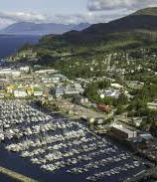
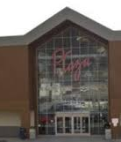

Ketchikan Resource Fair
September 12, 2025, 11AM-4PM
Plaza Mall Ketchikan, Alaska
Vendor registration released
  35 vendor tables available
  Currently, 11 vendors registered

Slide 9
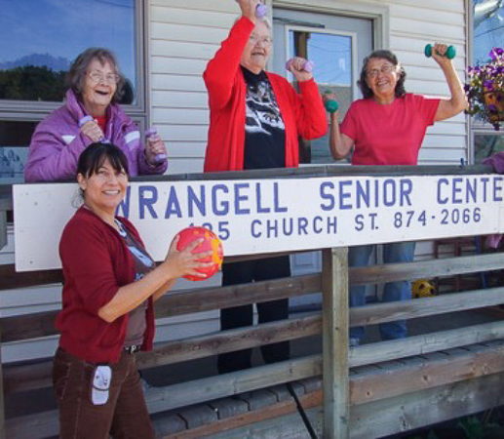
Regional Navigation: Senior Center Network
Senior Centers Technology
Ten Neat systems regionally have been installed in the regional Senior Centers. Ti Chi is being offered to multiple sites with plans for a Chair Yoga course among other activities.
Senior Centers have started to offer more activities per site. They are starting to have community groups coming to ask about engaging seniors in the shared space of the Senior Centers.
Senior Center Referral/Navigation Training:
  Intake documentation for Senior Centers have been adjusted to help collect data regarding unmet needs regionally and to support navigation.
  Staff Software training for data collection Jan-April weekly.
  Staff navigational training conducted April 22, 29 and May 1,8
Catholic Community Service (CCS) has posted three positions to support the project
  Hired, New Operations Manager- Filled
  Hired, JV Activities position - Filled
  Pending Activities/Cook (Ketchikan) - Filled
Data Collection:
Data collection has started and is pending submission into My Senior Center software.
Regional Elder Care Survey, Summer 2025 – planning stages by CCS
Identified that the United Way 211 has unmet need data collected by region that can be compared with community collection data

Slide 10
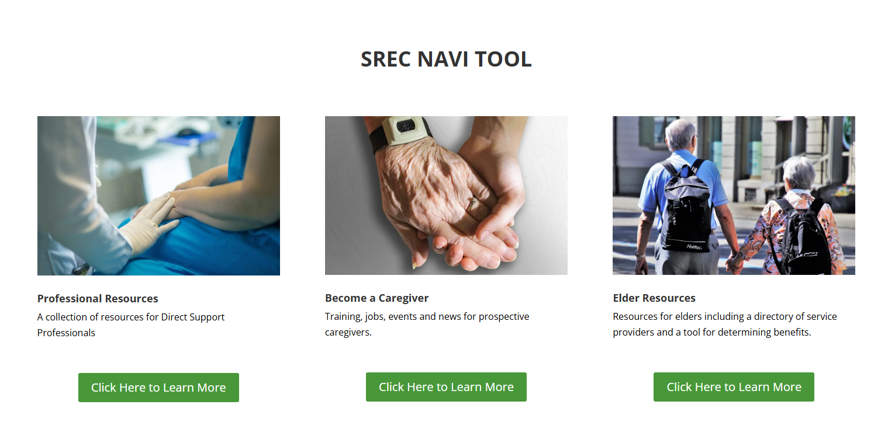
On-line Navigation: Navi Tool Website
Navi Tool, live site
Entrepreneurship Toolkits in partnership with Alaska Small Business Association
AI Chat bot added for assistance to summarize information and resource questions (Feb 2025)
  Survey on website, Minimal community feedback
  2.7K people accessed the website from March –June 2025
  Over 1400 people viewed website from NW region:
497 Juneau, Alaska
411 Anchorage, Alaska
384 Seattle, Washington
74 Ketchikan, Alaska
44 Sitka, Alaska
7 Haines
  Locating site from Google, Bing, and Directly
  Increased in site access following SREC events
Promotion of website and workforce:
  Coalition Meetings
  Coalition website
  Sitka Resource Fair
  T&H Resource Fair
  Community Connection Meeting

Slide 11
Entrepreneurship Tool Kit
A Business Tool Kit is being developed in partnership with the Alaska Small Business Development Center. The business tool kit will provide details for establishing an in-home care business to offer consumer directed and/or agency based in home care services.
Progress: Draft document created (June 2025)

Slide 12
Training Development
CNA through Juneau Campus of the University of Alaska Southeast:
SREC staff assisted with discussions with the Alaska Board of Nursing and the standing instructor at the UAS Sitka regarding the development of the spilt course and regional delivery course model.
November 7, 2024: UAS drafted a model of delivery to provide a CNA course as a split course. The classroom education (6-credit) would be offered through UAS Sitka Campus virtually with an adjunct professor in Juneau to provide Lab and Practical education (3-credit). Bartlett Regional Hospital would act as the practical site. UAS created a draft document to seek sponsorships for the course. Aiming for course delivery for Spring 2025. UAS had funding to hire an instructor and made an offer to a CNA instructor utilizing a course draft that had sustainably reduced costs then what they had asked for from SREC project staff.
SREC worked with Juneau Community Fund, who donated $10,000 toward tuition reduction for Juneau only residents.
UAS Dean of Vocational Education resigned, December 2024. The student count that he had initially provided to SREC and the Chancelor’s Office of 6 students who had completed application to the CNA course was false as there was no applications submitted to the university’s admission’s office.
UAS Chancelor had a meeting with Bartlett Regional Hospital and SEARHC but was unsuccessful negotiating a supportive agreement. SREC asked to participate to support a sustainability model, request declined. Bartlett Regional Hospital requested some kind of compensation for staff time for practical work with students in their long-term care facility. Funding was not included in the UAS proposal for sponsorship.

Slide 13
Training Development
CNA through Juneau Campus of the University of Alaska Southeast:
SREC met twice again with UAS interim Dean of Vocational Education and Bartlet Regional Hospital. UAS wanted to obtain full funding for the CNA course, tuition at full amount from students, plus an additional 35% of the total program costs above for in-direct cost to offer the course in Juneau only. SREC encouraged partnership with the Department of Labor and other educational resources to support students to have reduced tuition.
SREC staff agreed with the Interim Dean of Vocational Education to research and apply for grants to support the reopening of the Juneau Campus CNA courses. Application for a STEP grant was drafted but later declined by UAS noting that they had to have 2-3 months for internal approval and the required 35% of in-direct funding above the program costs even if JEDC/SREC Project staff managed the grant.
SREC returned grant for $10,000 back to Juneau Community Foundation, March 2025.
SREC staff continues to research grant funding options to share with the Dean of Vocational Education.
CNA training continues to be available in Juneau through Bartlett Regional Hospital, SEARHC, and by direct payment to either facility for outside agencies seeking staff training. It is not open to the general community.
Update May 2025, UAS reports that they have located funding and plans to hire a full-time nurse instructor in starting Fall Semester for an CNA rollout in Spring 2026.

Slide 14

Training Development
Understanding Dementia – 1 credit virtual delivery for UAS Ketchikan.
  Course has been added to the UAS course catalog. Being offered for the third time this Fall 2025. over 25+ students have completed the course to date.

Slide 15
Aging in Place, leverage resources:
Environmental Modifications
  Next steps:
  Additional funding is being researched for Construction workforce development. Rosarium Health, has a history of offering free community training.
  An Anchorage based pilot is being considered utilizing IDD agencies, we are pending additional information for involvement in SE Alaska. We are not wishing to overlap pilot programs.
  Immediate need is about 6+ people in the region. There are without a doubt more individuals who have unmet needs for home modification. But as the program has not been functional, they will need to be identified by care coordinators and take steps to be eligible for funding.
  SREC has continued to collaborate with SAIL/ADRC regarding Home modifications.
  SREC Project staff has started discussions with Rosarium Health, a national company who support contractors and aging-in-place. They have an interest in partnering for a pilot program in Se Alaska.
    Their proposal has been shared with other providers working with SAIL for possible additional partnership.
  SREC has coordinated with the regional Builder's Associations for support in offering a clear understanding of the Medicaid program and possible education for ADA requirements.

Slide 16
Aging in Place, leverage resources:
Environmental Modifications
SREC Identified 197 regional residential contractors.
SREC staff plans to conduct an interest survey of the Construction and Care Coordination providers in the region. The Southern Builder's Association has agreed to assist with webinar development to help promote interest in the industry and offered weekly newsletters to over 1000 participants in the construction industry.
Southern Builder's Association has been invited to attend the Ketchikan Resource Fair in September 2025.
Tonya Muldoon and Dan Bissinger have completed professional development through the National Association of Home Builders (NAHB) for accredited training as a Certified Aging in Place Specialist (CAPS).
Developing a program to broker construction contractors for seniors for aging in–place home renovation services. This will support regional pilots for the Environmental Modification pilots.
Developing ideas for a Summit 2026 based on Aging-in-Place topics and cross industry education.

Slide 17
Any Surprises or Learnings to Date

Slide 18
Research – What the Data says?
SREC Project staff through JEDC have been conducting surveys and research into the service gaps in the Southeast Region of Alaska (data collected through SOA DSDS). It has been determined that (2024):
201 individuals eligible for Personal Care services Medicaid Home and Community Based Wavier services or Community First Choice Services in Se Alaska that are 60+ years old (FY2025).
  55 Individuals are receiving Consumer Directed Personal Care Services through Medicaid Home and Community Based Wavier Services
  24 individuals receiving Consumer Directed Personal Care Services through a Community First Choice Services.
  0 individuals are receiving agency-based services, Personal Care Services through Medicaid Home and Community Based Wavier Services or Community First Choice Services.

Slide 19
Research – What the Data says?
FY 2024 134 individuals 60+ years old received services through a Medicaid Home and Community Based Wavier.
Services provided through Medicaid Home and Community Based Wavier Services for individuals who are 60+ years:
  5 individuals Transportation with escort
  7 individuals Transportation via paratransit
  149 individuals Care Coordination
  83 individuals Residential Supportive Living
  11 individuals In-Home Support
  17 individuals Day-Habilitation Service
  0 individuals Family Home Habilitation Service
  27 individuals Respite
  1 individual Nursing oversight and care management
  0 individuals Specialized Private Duty Nursing
  5 individuals Adult Day (Half Day)
  27 individuals Adult Day (15min intervals)
  0 individuals Environmental Modifications

Slide 20
Research – What the Data says?
1406 individual meals are prepared through the Meals on Wheels program throughout the region weekly (CCS).
  4 individuals supported by Medicaid Home and Community Based Wavier Services are receiving home delivered meals
  2 individuals supported by Medicaid Home and Community Based Wavier Services are receiving congregate meals through Medicaid Home and Community Wavier Services.

Slide 21
Research – What the Data says?
United Way 211 reports for FY2024 for Southeast Alaska
  385 Calls seeking information for: Food/meals, Legal consumer and Public Safety Services, and housing.
  486 referrals with unmet needs for food pantries, summer food programs, and formula/baby food.
Southeast Alaska Elder Advisory Committee: Alaska Native Successful Aging Study (2024)
  Reasons Elders Leave their communities:
    Accessing specialized medical care
    Lack of economy for adult children to return to the village community

Slide 22
Project Changes

Slide 23

Rate Review to Business Vitality Study
Rate Review: SREC members have met several times with Sandra Heffern, regarding conducting a private Medicaid rate review to determine the feasibility of providers to offer Personal Care Services especially for business development. Some agencies involved are conducting a concurrent SOA rate review of total services resulting in their lack of time to engage in a secondary review.
Study to review recent State of Alaska Medicaid rate review submissions plus additional financial records for comparison and determination of vitality of businesses long term.
Projected outcome: To learn the financial stability needs of regional agencies to determine how best to advocate for additional financial supports. Such as finding long-term subsides for benefit packages or workforce develop skills.
Status: Inquiry of agencies. Contract created.

Slide 24
Project Changes
November 2024
July 2025
December 2023
Regional Eldercare Summit
Developing plan for a resource fair in Sitka, Spring 2025 and Ketchikan, Fall 2025. Respondents have requested a second Summit event to occur, possibility 2026.
Developing a plan for Ketchikan Resource Fair September 12, 2025, and Summit to occur in 2026 themed around Aging-in-place and the resources needed to do so.
Financial Incentives
Most community providers declined financial incentives from the SREC project. Travel for providers to the Summit was the most sot after funding.
Utilizing remaining funding for financial incentives related to a Summit for 2026.
Hiring and referral bonuses, only CC has asked as of June 2025.

Slide 25
Project Changes
July 2025
Additional Media Promotion
  Monthly elder service promotion via social media
  Creating ads for recruitment for community and family seeking to be employed as a caregiver

Slide 26
SREC Outcomes
Improved access and awareness of Eldercare resources and services through workforce development, retention, and navigation
Administration of SREC Coalition
Increased Workforce
Summit
Financial Incentives
Elder Reimbursement Pilot
Improved Quality Life for Elders
Improved Retention
NAVI Tool
SREC Project
Relias, UAS, and PATH Training
Improved Leadership
Entrepreneurship Toolkit
Environmental Modifications
Improved Staff Support
Senior Centers
Video Technology
Navigation + Elder Driven Activities
Regional Data Collection
Improved Autonomy and Dignity
Resource/job Fairs
Notes:
Excludes Youth Camps, Teal Street Office, Summit has been completed.

